Slide 1
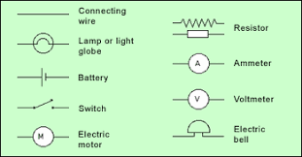
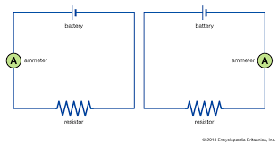
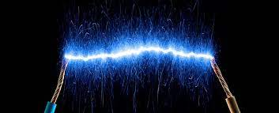
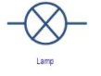
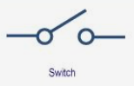
Science-electricity
Key Outcomes
Electricity I will be able to construct a circuit I will be able to recognise that changing components of the circuit will change the outcome I will be able to recognise and use circuit symbols I will know that different voltage will mean a difference in brightness of a bulb or power of a motor The skills that I will use (working scientifically) Planning different types of scientific enquiries to answer questions, including recognising and controlling variables where necessary Taking measurements, using a range of scientific equipment, Record data Using test results to make predictions to set up further comparative and fair tests Reporting and presenting findings from Identify scientific evidence that has been used to support or refute ideas or arguments
Key Vocabulary
Electrical Circuit | A closed loop where power can run through it and power items
Symbol | A mark or diagram that represents something. Eg:
Component | A part of a larger whole, such as: a cog on a bike
Cells | A unit in something that turns energy into electricity. Eg: a cell battery can power a watch
Voltage | An electronic force or measurement
Filament | A thin wire that can be found in a bulb
Enquiry | An investigation to find the answer to a question
Prior Knowledge
I can create a simple circuit I can ‘write-up; experiments I know some scientific words such as : fair test and circuit

