Slide 1
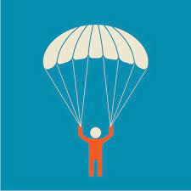
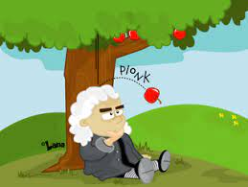
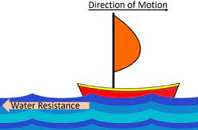
Science-Forces
Key Outcomes
Forces Children can unsupported objects fall towards the Earth because of the force of gravity acting between the Earth and the falling object Identify the effects of air resistance, water resistance and friction, that act between moving surfaces Recognise that some mechanisms, including levers, pulleys and gears, allow a smaller force to have a greater effect. The skills that I will use Planning different types of scientific enquiries to answer questions, including recognising and controlling variables where necessary Taking measurements, using a range of scientific equipment, Record data Using test results to make predictions to set up further comparative and fair tests Reporting and presenting findings from Identify scientific evidence that has been used to support or refute ideas or arguments
Key Vocabulary
Friction | A force that acts between two surfaces or objects that are moving, or trying to move, across each other.
Gravity Mechanisms | A pulling force exerted by the Earth (or anything else which has mass). Mechanisms are simple machines with moving parts that change input forces and movement into a set of useful output forces.
Forces | Pushes or pulls
Weight | The measure of the force of gravity on an object.
Mass | A measure of how much matter (or ‘stuff’) is inside an object.
Air resistance Water resistance | A type of friction caused by air pushing against any moving object. A type of friction caused by water pushing against any moving object.
Buoyancy | An object is buoyant if it floats. This is because the weight of the object is equal to the upthrust
Prior Knowledge
I can name different forces I can ‘write-up; experiments I know some scientific words such as : fair test and frictions

