Slide 1
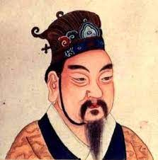
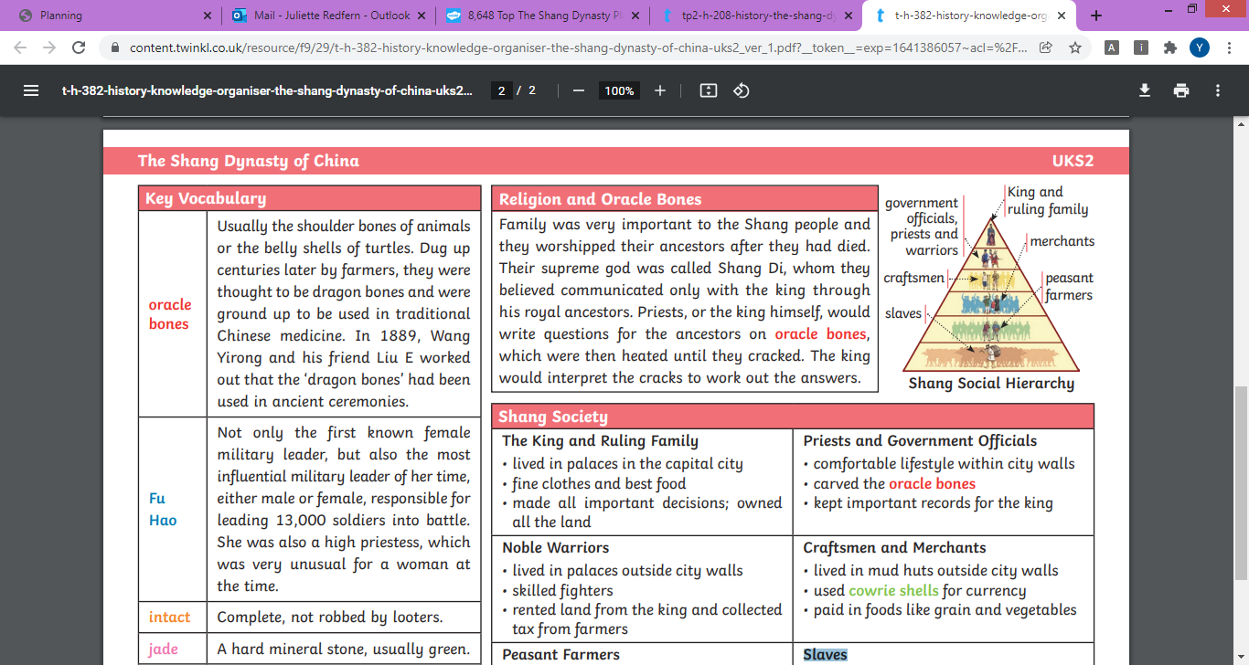
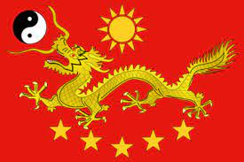
History
The Shang Dynasty of China
Key Outcomes
To discover when the Shang Dynasty of China was To closely study the life of Chinese civilians during the Shang Dynasty of Chins To look at individuals from the Shang Dynasty of China (including Fu Hao) To use primary and secondary sources To compare this era to the modern day world
Key Vocabulary
oracle bones | Usually the shoulder bones of animals or the belly shells of turtles. Dug up centuries later by farmers, they were thought to be dragon bones and were ground up to be used in traditional Chinese medicine. In 1889, Wang Yirong and his friend Liu E worked out that the ‘dragon bones’ had been used in ancient ceremonies.
Fu Hao | Not only the first known female military leader, but also the most influential military leader of her time, either male or female, responsible for leading 13,000 soldiers into battle. She was also a high priestess, which was very unusual for a woman at the time.
cowrie shells | Small, flat, yellowish seashells, used like coins in trading.
jade | A hard mineral stone, usually green.
Shang Society | The King and Ruling Family/Noble Warriors/Peasant Farmers/Priests and Government Officials/Craftsmen and Merchants/Slaves
Shang Social Hierarchy | The order of importance of different groups in society
Shang Di | The supreme god
Prior Knowledge
I know where China is on the map I have compared older civilisations with the modern world previously I can evaluate primary and secondary sources

