Slide 1
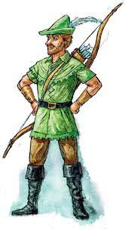
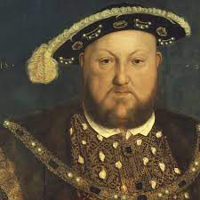

History –Crime and punishment
Key Outcomes
To learn to recognise different historical sources To identify if a source is a primary or secondary one To use sources to answer questions about historical figures To discuss crime and punishments from the historical eras To evaluate the difference in attitudes to crime and punishments over time
Key Vocabulary
Primary source | A historical piece of evidence created at the time being looked at
Secondary source | A source that analyses or uses primary sources to answer historical questions
Source | A piece of evidence
Evidence | Something that can be used to help answer question, such as: a diary, photograph or fossil
Punishment | A consequence for doing something against the law
Evaluation | Investigating and making a conclusion about something that is studied
Crime | An act that is against the law
Prior Knowledge
I know what crime and punishment is I have used historical sources previously I have evaluated evidence to consider if it is accurate

