Slide 1
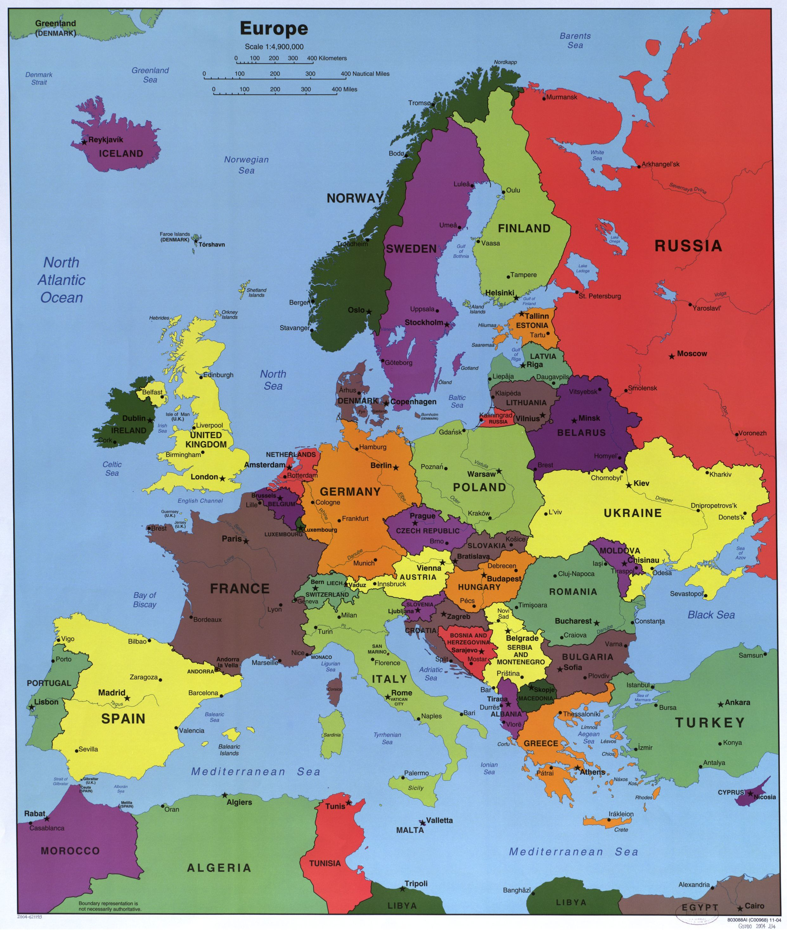
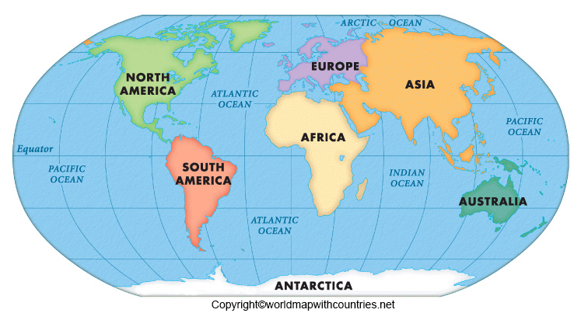
Geography – Where in the World?
Key Outcomes
To be able to locate the world’s countries with a particular focus on Europe (including the location of Russia) and North and South America using maps, globes and atlases. Know and locate countries and major cities within these areas. Know and locate environmental regions with these areas. Study key physical and human characteristics of these areas To use the eight points of a compass and four and six-figure grid references to locate features.
Key Vocabulary
Continent | A large region of the world containing lots of different countries
Atlas | A book that contains maps or charts
Environmental region | An area defined by its environmental conditions; especially climate, landforms, and soil characteristics.
Human geography | how human activity affects or is influenced by the earth's surface.
Physical geography | The world’s natural features
Compass | An instrument containing a magnetised pointer which shows the direction of magnetic north and bearings from it including North, East, South and West.
Grid references | A map reference indicating a location in terms of a series of vertical and horizontal grid lines identified by numbers or letters.
Prior Knowledge
Children can name and locate the 7 continents of the world. Children can name and locate the 5 oceans of the world . Children can use maps, globes and atlases to locate countries.

