Slide 1
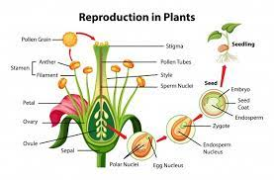
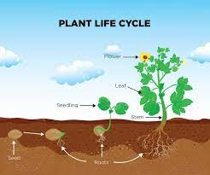
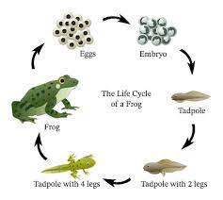
Science-Living things and habitats (year 5 curriculum)
Key Outcomes
I will be able to describe the differences in the life cycles of a mammal, an amphibian, an insect and a bird I will be able to describe the life process of reproduction in some plants and animals The skills that I will use (working scientifically) Planning different types of scientific enquiries to answer questions, including recognising and controlling variables where necessary Taking measurements, using a range of scientific equipment, Record data Using test results to make predictions to set up further comparative and fair tests Reporting and presenting findings from Identify scientific evidence that has been used to support or refute ideas or arguments
Key Vocabulary
Plant reproduction | Plant reproduction is the production of new offspring in plants
stamen | A stamen is the male reproductive organ of a flower.
botanical | of or relating to plants or botany or something that is taken from plants
mammal | a warm-blooded vertebrate animal of a class that is distinguished by the possession of hair or fur, females that secrete milk for the nourishment of the young, and (typically) the birth of live young
amphibian | a cold-blooded vertebrate animal of a class that comprises the frogs, toads, newts, salamanders, and caecilians. They are distinguished by having an gills to breath.
Life process (cycle) | Life processes are the series of actions, such as movement, respiration, sensitivity, growth, reproduction, excretion and nutrition that are essential for a living being to be able to live.
Gametes metamorphosis | Gametes are an organism's reproductive cells. They are also referred to as sex cells. Female gametes are called ova or egg cells, and male gametes are called sperm is a stage in the growth of some animals in which the new form looks completely different from the old
Prior Knowledge
I can describe what a mammal is I can describe the difference between plants and animals I can describe the life cycle of a human

