Slide 1
The geography of food
Farms and factories: where does our food come from?

Slide 2
how to use Oak lessons

Slide 3
I can describe the processes involved in commercial bread production.

Slide 4
food production
processing
distributing
retailers
commercially

Slide 5
Food production is the process of turning raw materials into food that can be eaten.
Processing means making changes to a food’s natural state. An example is cooking beans in a tomato sauce and preserving them in tins.
Distributing is delivering something out to where it is needed.
Retailers are people or businesses that sell goods.
If something is produced commercially it is made for the purpose of making money.

Slide 6

The geography of food
Asking questions about food
How is food produced?

Slide 7



Asking questions about food
In this unit we are going to be learning about food.
What is your favourite food to eat? Which foods do you like the least?
I don’t like eating fish
My favourite food to eat is pizza
Aisha
Jun

Slide 8
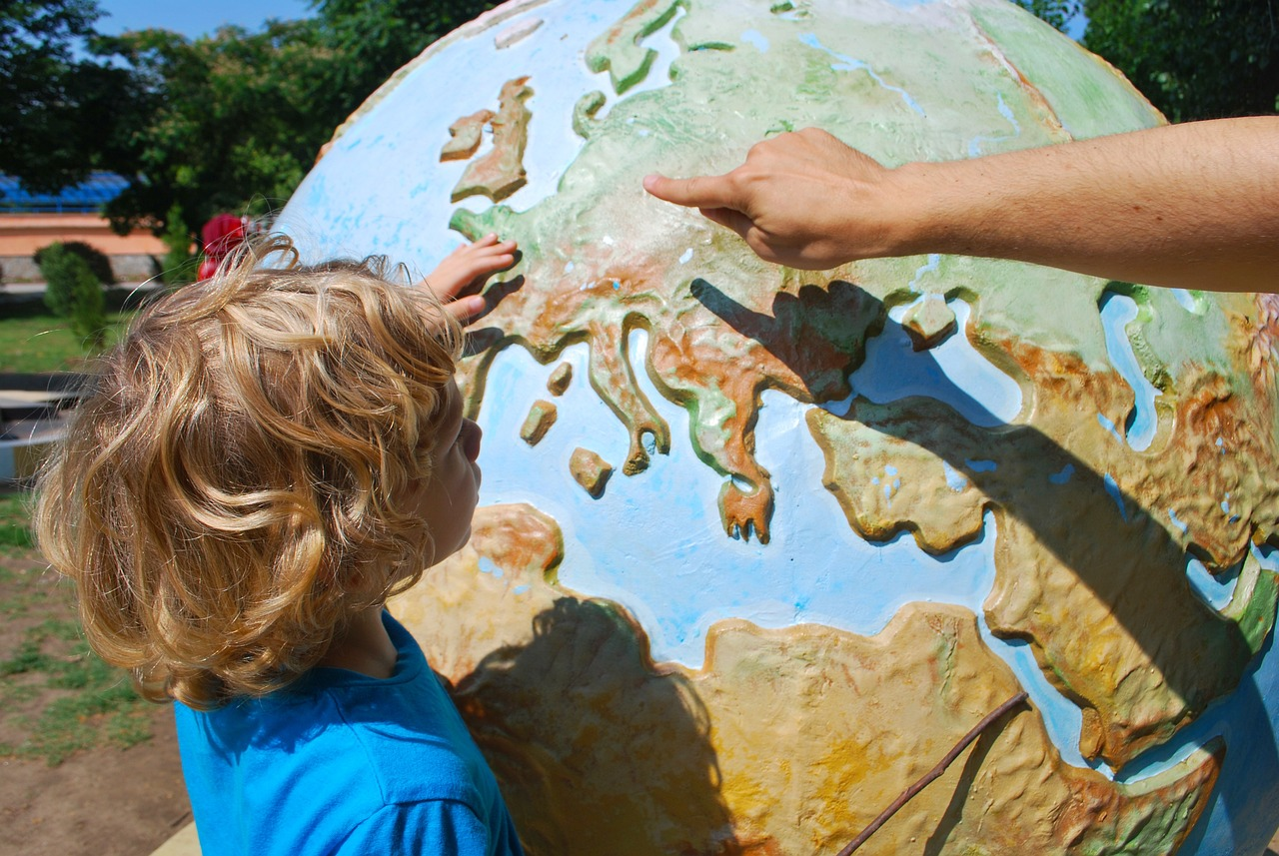
Asking questions about food
Geography is the study of the world.
Geography is learning about different places, environments and people and the relationships between these.

Slide 9
Asking questions about food
We can think of the geography of food as the study of how and where food is produced and consumed. We can use questions to investigate the geography of food.
How have people’s diets changed over time?
Jun
What similarities and differences are there between people’s diets around the world?
Aisha

Slide 10
Asking questions about food
Asking questions helps us to:
consider any existing knowledge we have about a topic
think more deeply and solve problems
make connections between what we learn at school and our own lives and experiences

Slide 11
Asking questions about food
Think of three questions you would like to investigate about the geography of food. Share your ideas with someone else.
1
2
3

Slide 12

Asking questions about food
Why do different crops grow in different places?
Andeep
Is there enough food for everyone to eat?
What might we eat in the future?
Aisha
Jun

Slide 13
The geography of food
Asking questions about food
How is food produced?

Slide 14
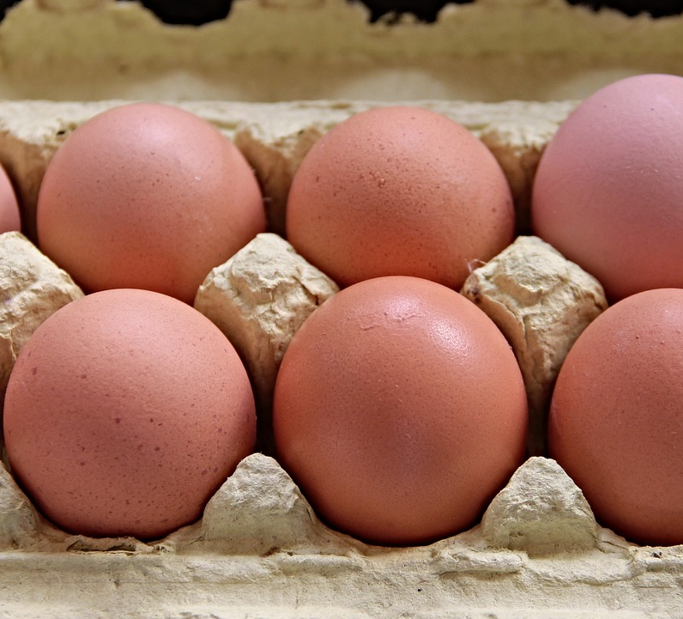
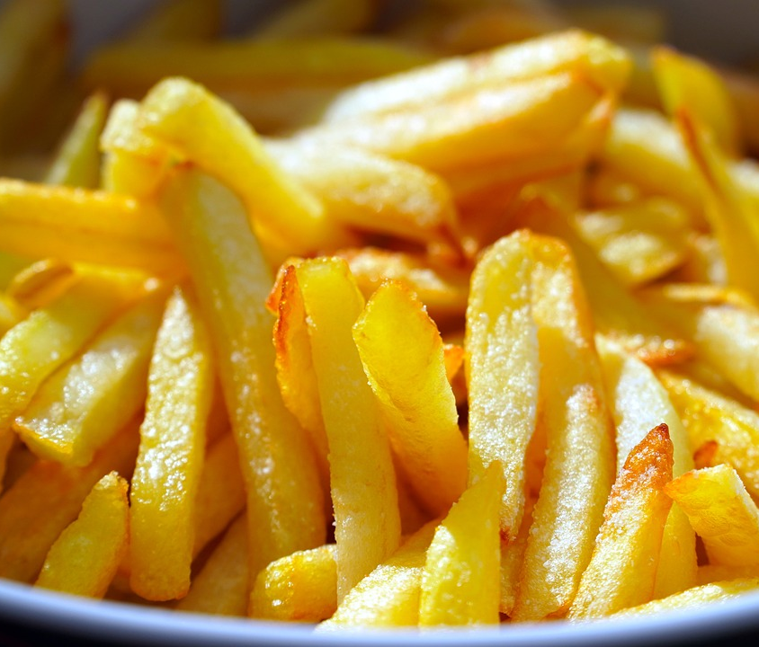
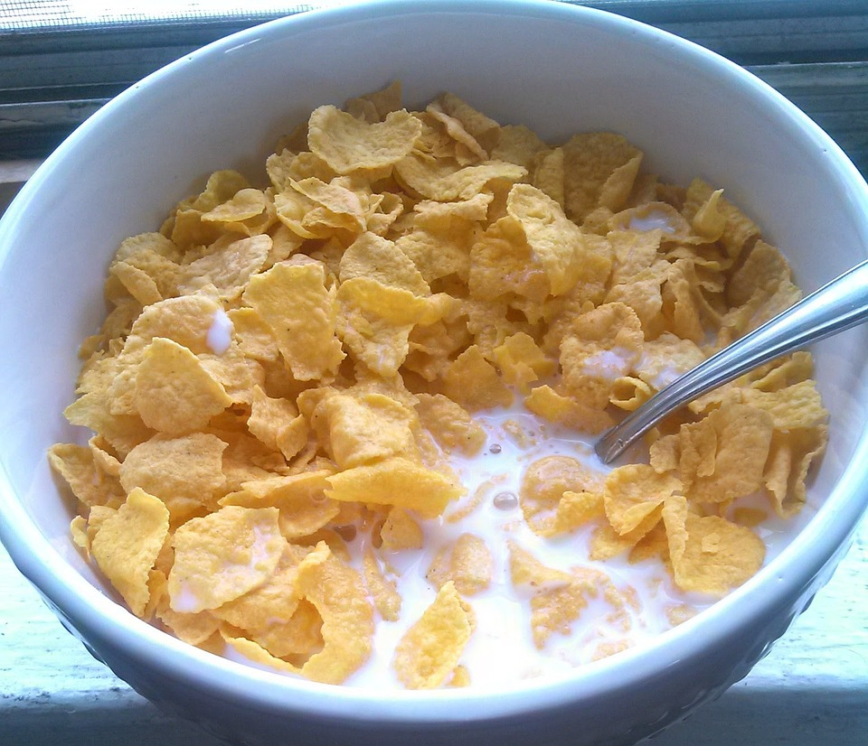
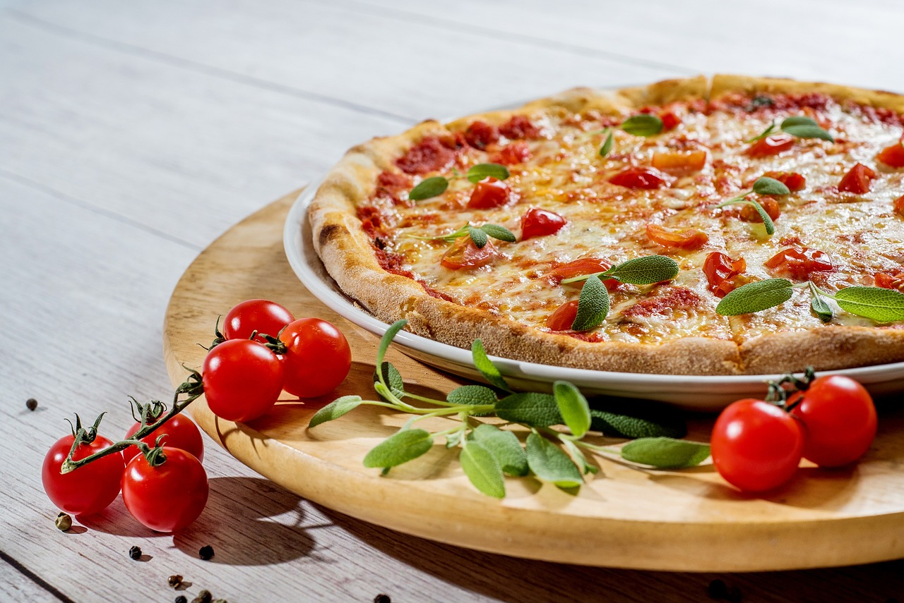
How food is produced?
Let’s think about how our food is produced.
How do these foods get to your plate?

Slide 15
How food is produced?
How the food we eat is produced, processed, distributed and consumed is complex but it all comes from plants and animals. What plants and animals are used in the production of the foods shown here?
Eggs are from birds like hens. Chips are made from potatoes. Cornflakes are made from corn. Pizza is made from wheat for the base, tomatoes for the sauce and milk for the cheese
Jun

Slide 16
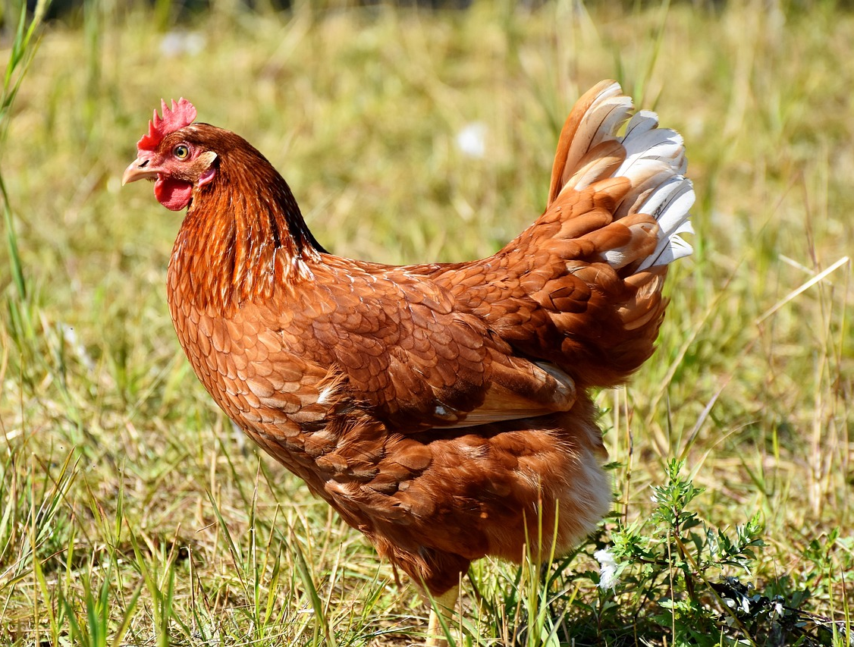
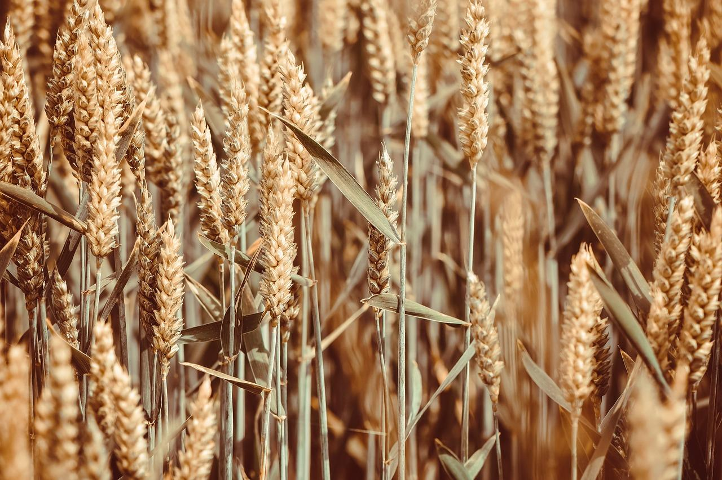
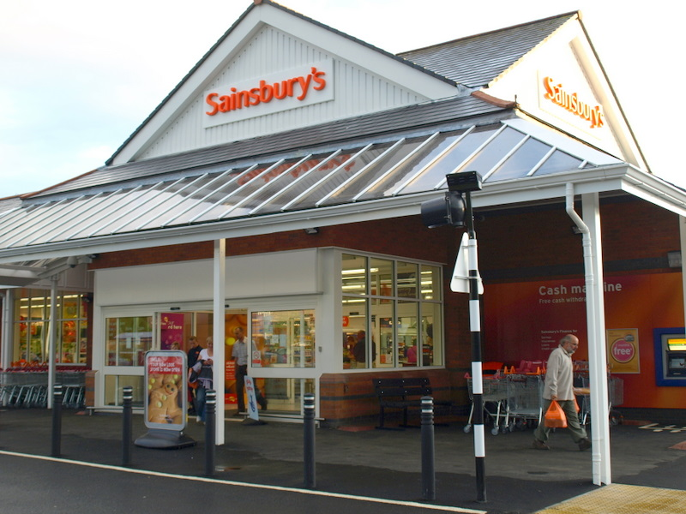
How food is produced?
Much of the food we eat makes a journey from farms, where animals are reared and crops grown, to shops where people purchase it.
Photo Right: New supermarket, B4bees, 2009, Licensed under CC BY 2.0

Slide 17
How food is produced?
There are often many different stages involved in food production:
growing crops or rearing animals
processing food to make it into food that can be eaten or stored
packaging food
distributing food to retailers to be sold
transporting food to people’s homes
being eaten or wasted

Slide 18
How food is produced?
Name one of the stages often involved in food production.
growing crops or rearing animals
processing food
packaging food
distributing food to retailers to be sold
transporting food to people’s homes
being eaten or wasted

Slide 19
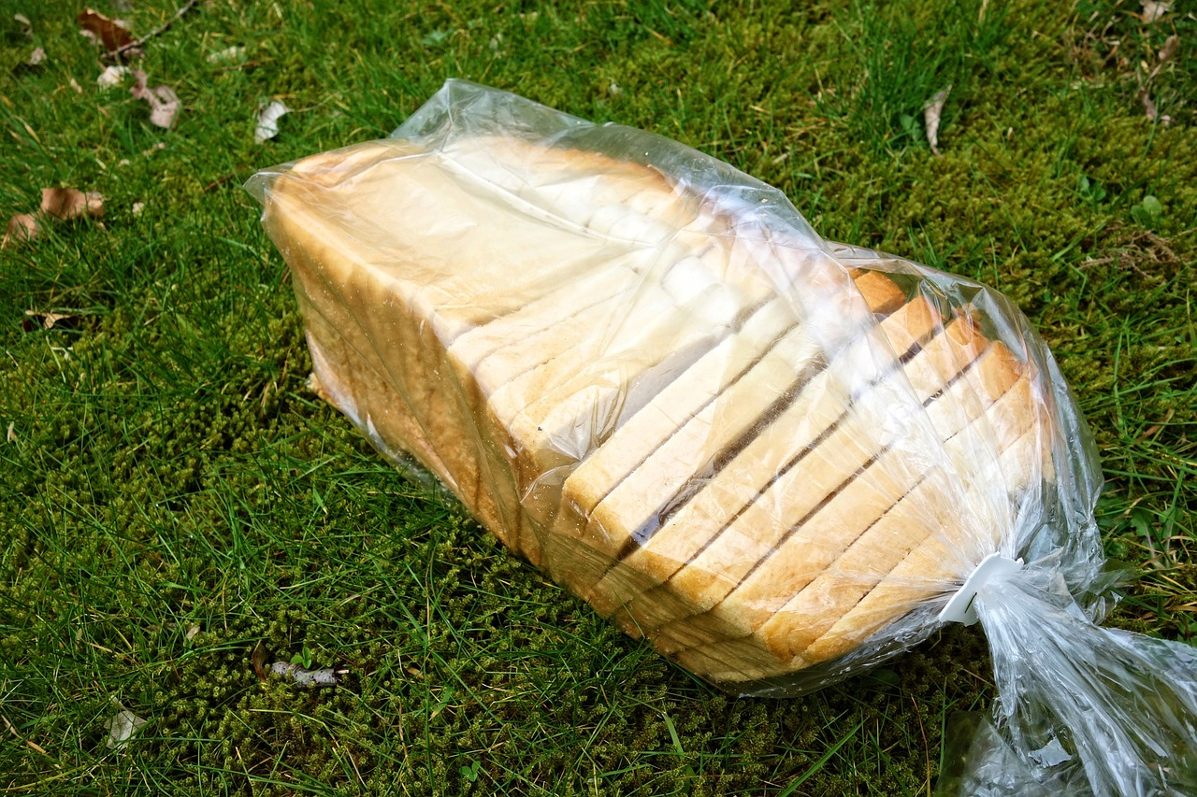
How food is produced?
We are going to investigate how bread is made commercially. We will find out where the ingredients come from and how the bread is produced.

Slide 20
How food is produced?
The main ingredient of bread is often wheat though other grains can also be used. Wheat is a major crop in the UK - 85% of the wheat we use is grown in the UK.
The ears of wheat contain the grains which are used to make bread.

Slide 21
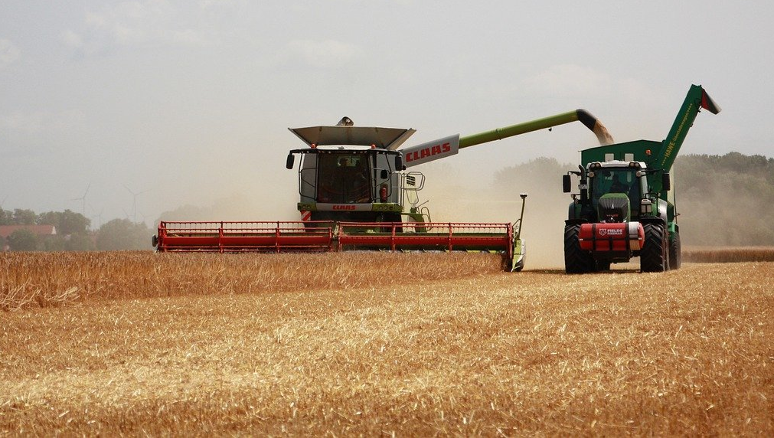
How food is produced?
The wheat is harvested (cut) and the grains are separated from the stalks.
combine harvester
In the UK, a hectare of wheat (an area about the size of a football pitch) produces an average of 7.8 tonnes of grain in a year. That’s enough to make almost 12,000 loaves of bread!
Data sources:
https://www.fao.org/faostat/en/#data/QCL
https://www.countrysideonline.co.uk/articles/crops-learn-about-the-uk-arable-sector/

Slide 22

How is food produced?
Which crop is often the main ingredient of bread?
barley
corn
oats
wheat

Slide 23
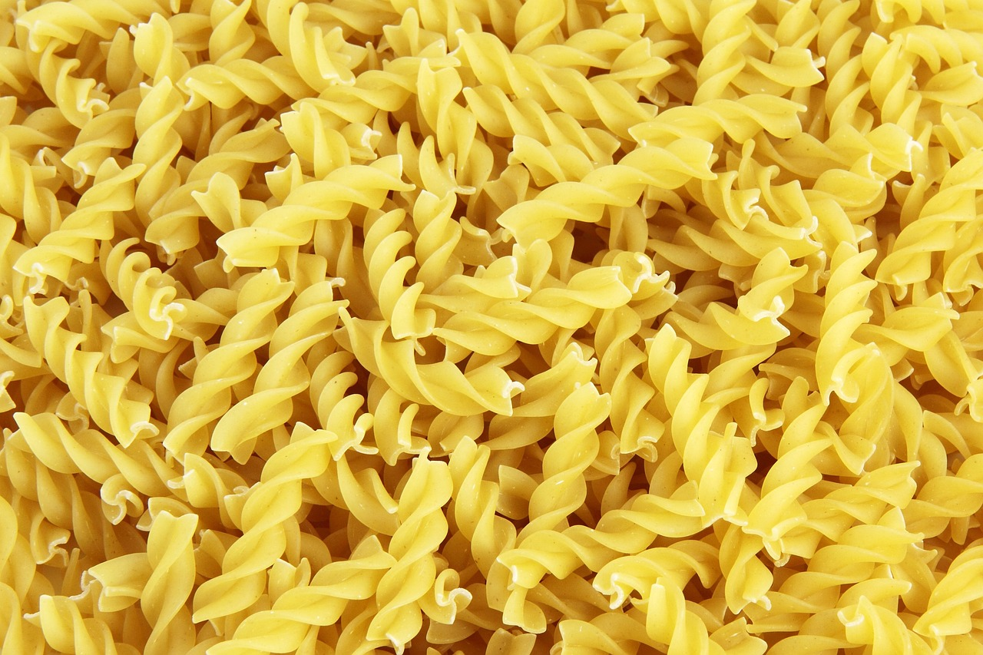
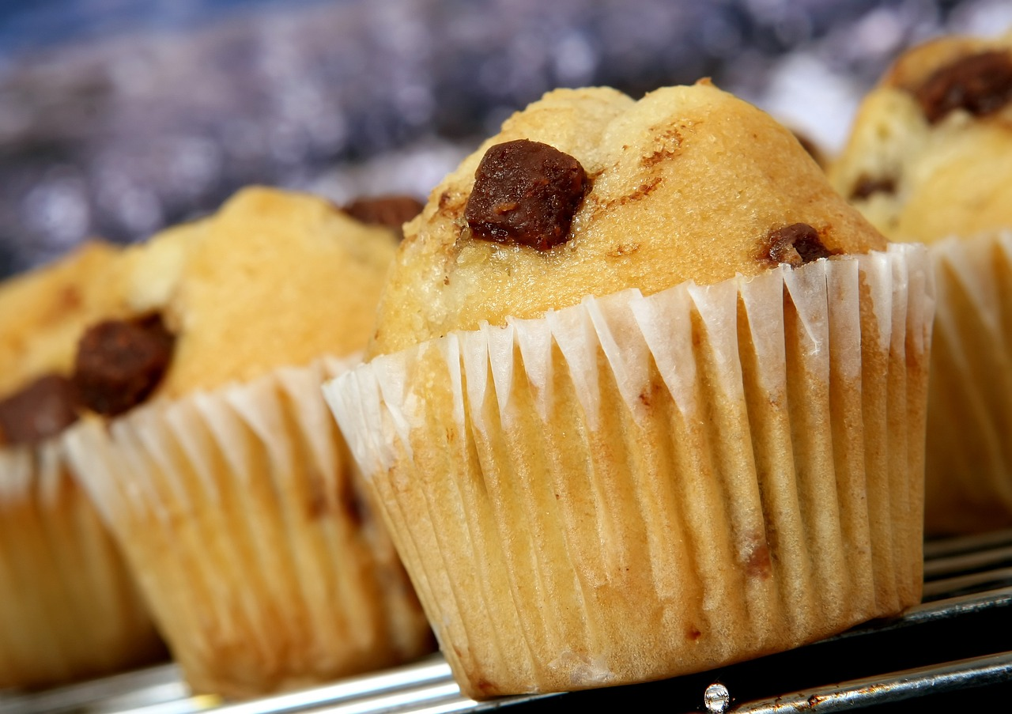
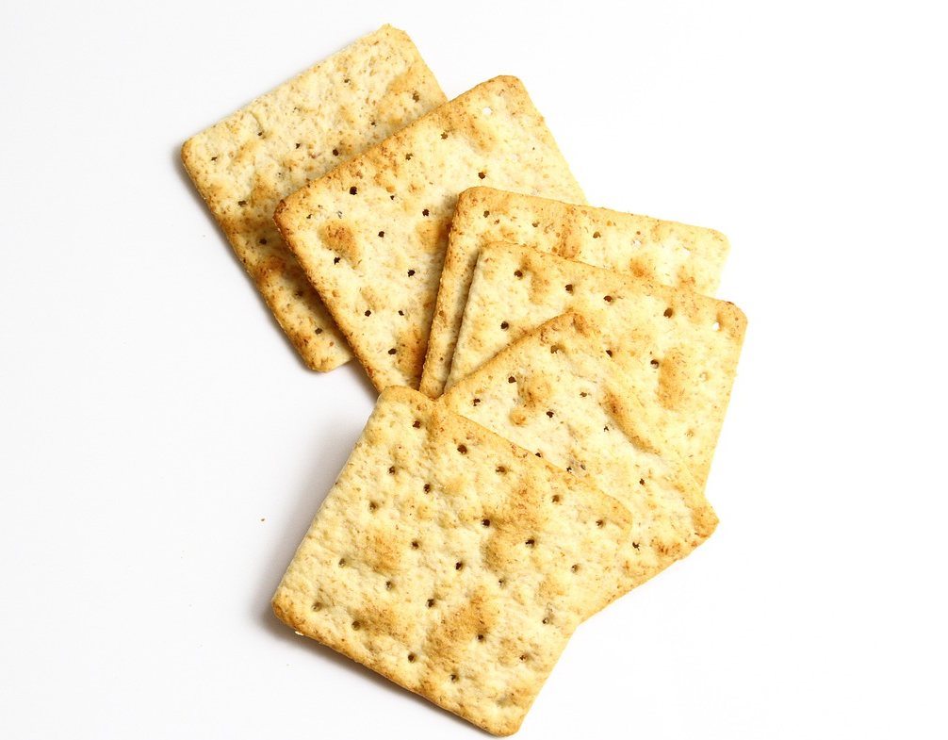
How food is produced?
About a third of all the grocery items in our supermarkets contain wheat flour. What foods can you think of that contain wheat flour?

Slide 24
How is food produced?
What two processes take place during milling? Select two answers.
adding water
grinding
removing dirt and impurities
roasting

Slide 25
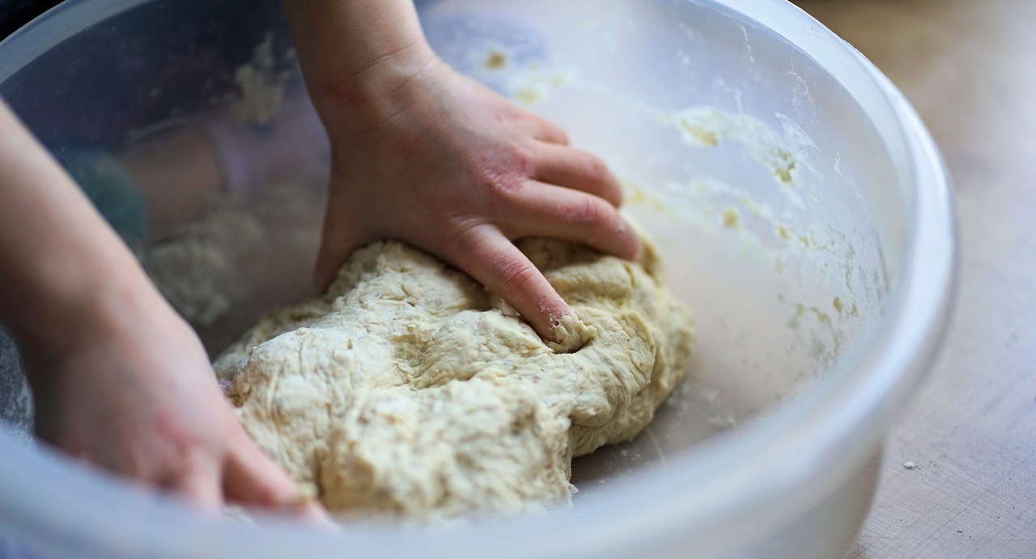
How food is produced?
The flour is then mixed with water, yeast and salt to form a dough. Other ingredients are often added as well, such as sugar, fat and emulsifiers. The dough is then shaped and baked in an oven to make bread.
There are lots of different types, shapes and sizes of bread.

Slide 26
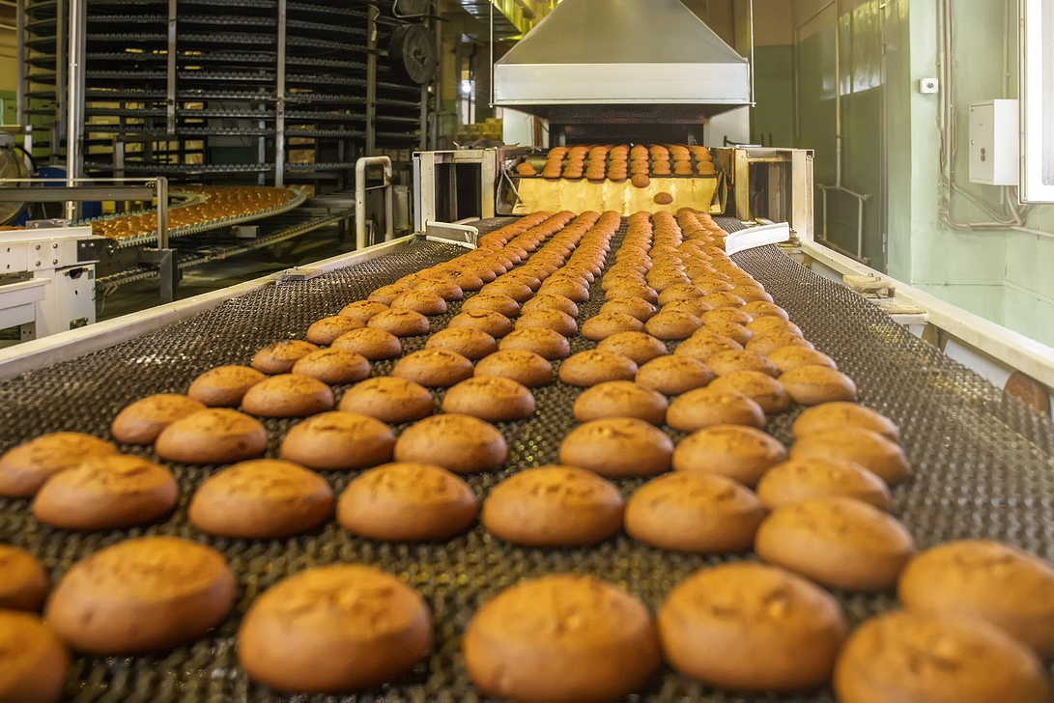
How food is produced?
Most of the bread we eat is produced in large amounts by machines in factories.

Slide 27
How food is produced?
Most of the bread we eat is made in small bakeries.
Most bread is produced by machines in factories. This means bread can be produced in large quantities very quickly.
Most of the bread we eat is made at home.

Slide 28
How food is produced?
The bread is then packaged. Plastic is often used for packaging. There are advantages and disadvantages of using plastic.
Plastic packaging keeps the bread fresh and dry, but single use plastic is bad for the environment
Jun

Slide 29
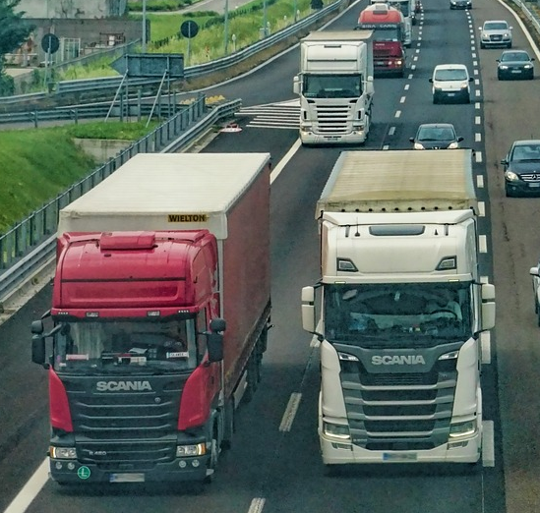
How food is produced?
The bread is then transported to retailers such as supermarkets to be sold.
The bread is then transported to people’s homes after they buy it in a supermarket. They might walk or use a car or a bus to transport it home
Jun

Slide 30
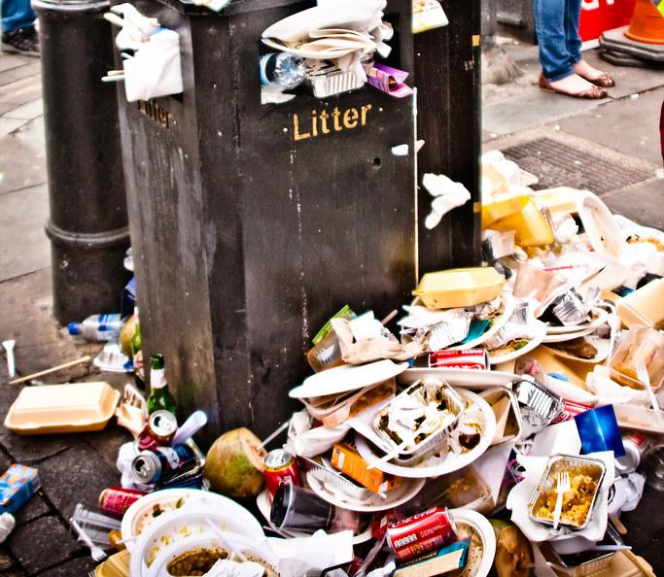
How food is produced?
People have eaten bread for hundreds of years. Nearly 11 million loaves of bread are sold in the UK every day!
Not all of the bread produced is eaten. Some of it ends up as waste. Almost 25% (one quarter) of the food purchased in the UK is wasted.
Bread is one of the most wasted food and drink items in the UK.
Every day, we throw away the equivalent of 25 million slices of bread!
Stuffed, Garry Knight, 2011, Licensed under CC BY 2.0

Slide 31
How is food produced?
What percentage of the food purchased in the UK is wasted?
almost 5%
almost 15%
almost 25%
almost 35%

Slide 32
How is food produced?
Order the stages of commercial bread production.
1.
2.
3.
crop
harvest
processing
6.
5.
4.
distribution
packaging
production
7.
8.
eating
waste
crop
distribution
eating
harvest
packaging
processing
production
waste

Slide 33
How is food produced?
Draw and describe what happens at each stage of commercial bread production. Use the boxes to help you.
Crop
Harvest
Processing
Production
Packaging
Distribution

Slide 34
How is food produced?
Here is an example answer.
Crop | Wheat is grown in fields by farmers.
Harvest | When the wheat is fully grown it is harvested by cutting it.
Processing | The wheat is separated from the stalks and husks and ground into flour.
Production | The flour is mixed with yeast, water, salt and other ingredients and then shaped and baked.
Packaging | The bread is packed in bags or wrapped in waxy paper.
Distribution | The bread is delivered to shops and supermarkets in huge delivery trucks.

Slide 35
The geography of food
How food is produced, processed, distributed and consumed is complex but it all comes from plants and animals.
Much of the food we eat makes a journey from farms, where animals are reared and crops grown, to shops where people purchase it.
Several different stages are involved in the commercial production of bread.

Slide 36

© Oak National Academy 2024.
Produced in partnership with The Geographical Association.
Licensed on the Open Government Licence v3.0, except where otherwise stated. See Oak terms and conditions.

