Slide 1
Introducing sustainability
Sustainable world: does it matter how we live?

Slide 2
How our teaching resources are designed for the classroom

Slide 3
I can explain what sustainability means to me and start to identify choices that can be made with this in mind.

Slide 4
natural resources
Natural resources are those that
come from Earth without human influence and can be used for human needs.
inequality
Inequality is when something is not shared evenly between everyone.
consumption
Consumption is the process of using up resources.

Slide 5

Introducing sustainability
What is sustainability?
Why is there a need for sustainability?
Do our choices matter?

Slide 6

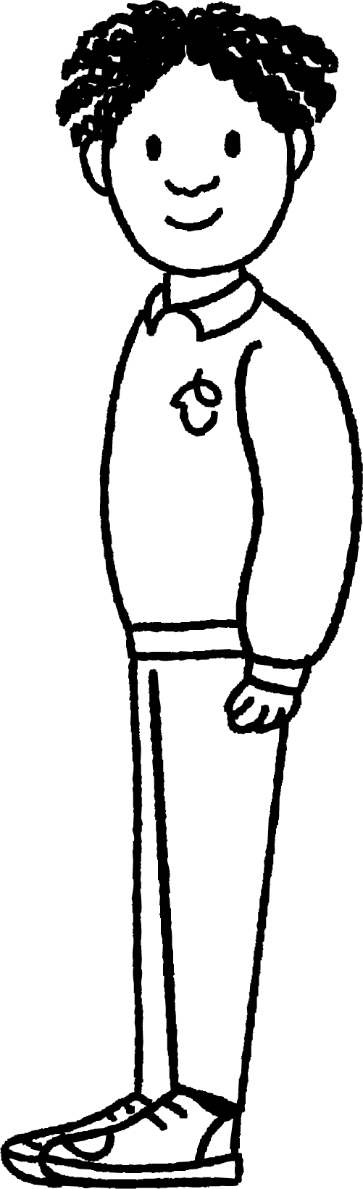


What is sustainability?
I keep hearing people talk about sustainability.
Me too. The Prime Minister was even talking about it on the news.
I’m not really sure what it means. Do you know what sustainability is?

Slide 7

What is sustainability?
In 1987, the United Nations defined sustainability as:
“Meeting the needs of the present without compromising the ability of future generations to meet their own needs”.

Slide 8
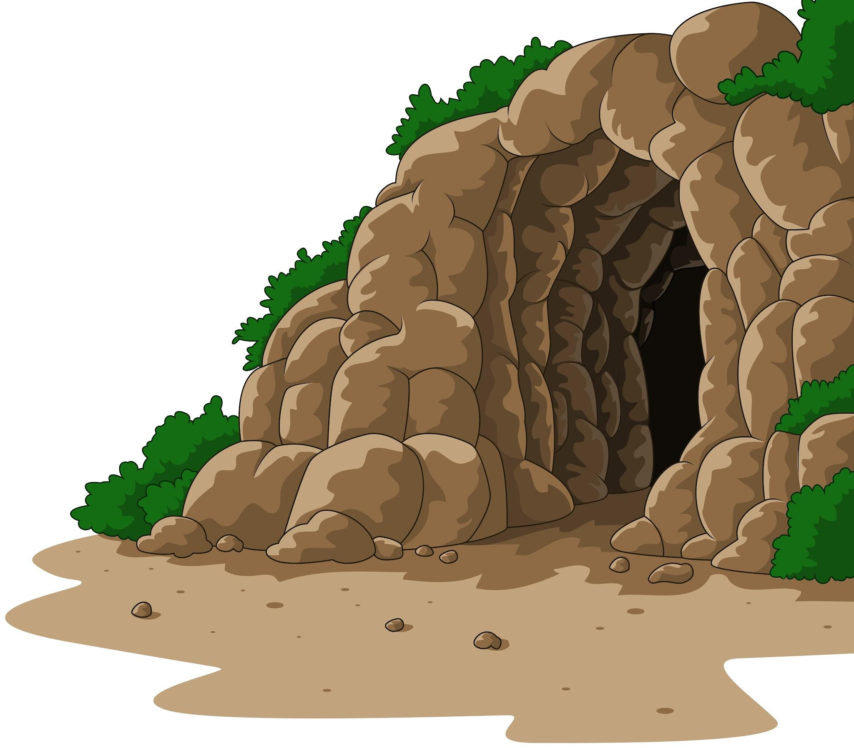

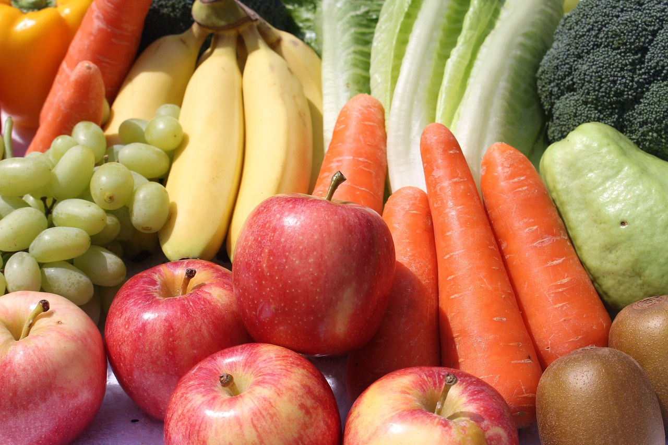
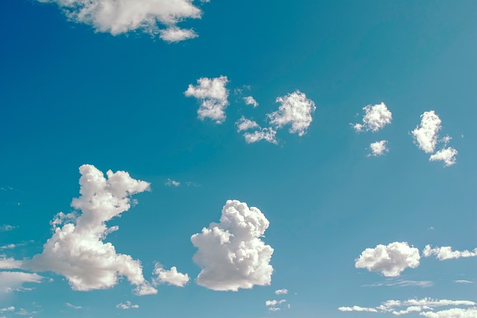
What is sustainability?
Humans have some basic needs:
shelter
warmth
food and water
air
Some needs are essential for life and some are non-essential.
Photo a: Teguh Mujiono/Shutterstock.com

Slide 9

What is sustainability?
Which of these are essential human needs?
shelter
soft bed
food
warmth

Slide 10
What is sustainability?
“Sustainability is a way of using resources that could continue forever. A sustainable activity is able to be sustained without running out of resources or causing harm.
If something is unsustainable, it means it’s using up resources faster than they’re being replaced. Eventually the resources will run out and the activity won’t be able to carry on.”
Greenpeace, 2024

Slide 11
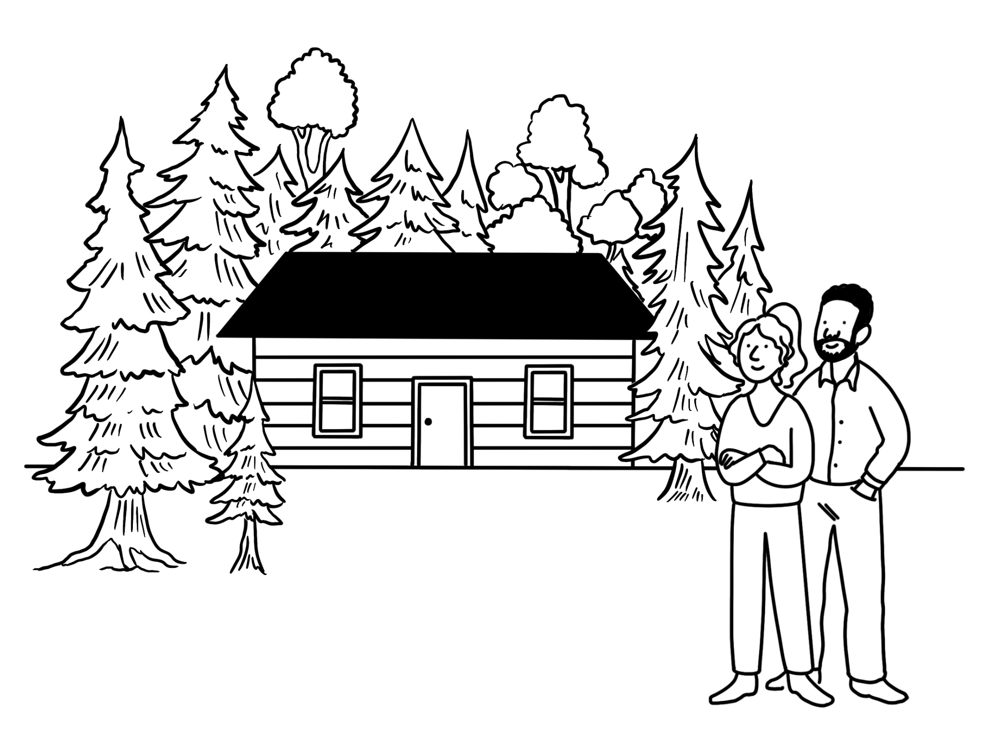
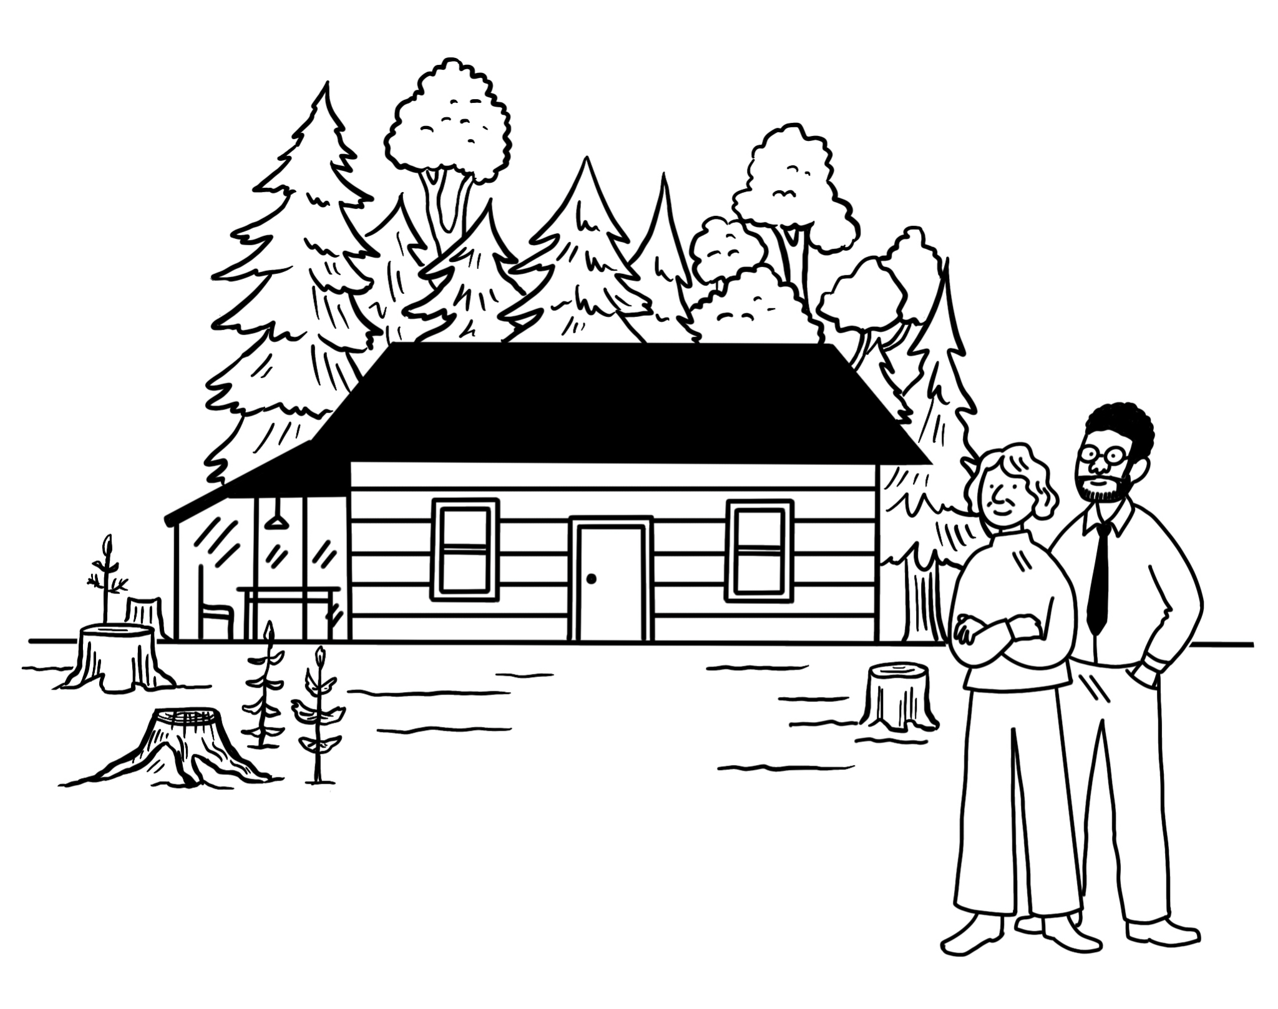
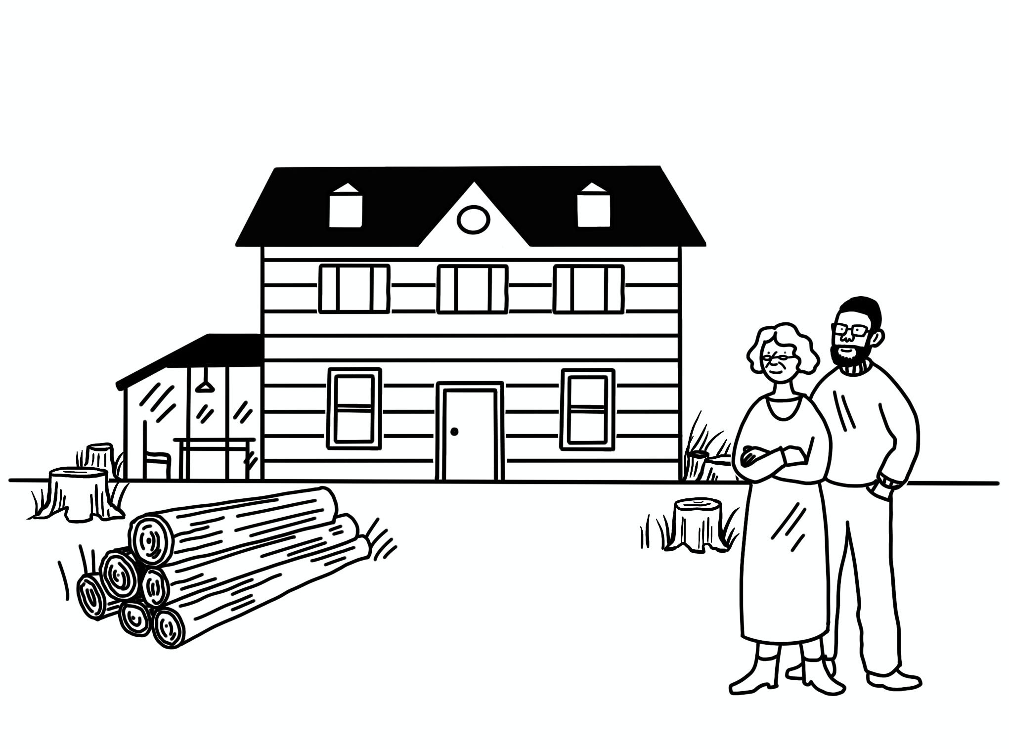
What is sustainability?
Using our natural resources
Trees are a resource we use. If we cut them down without replanting them there will be none left for people to use in the future. This is not a sustainable way to use this resource.

Slide 12

What is sustainability?
What do these definitions have in common?
“Meeting the needs of the present without compromising the ability of future generations to meet their own needs.” UN, 1987
“Sustainability is a way of using resources that could continue forever.” Greenpeace, 2024
a
They both say something about the future.
They suggest that we are using up the planet's resources too quickly.
b
They suggest that the way many people live today can carry on as it is.
c
Sustainability can be defined as meeting the needs of today without preventing future generations from doing so.

Slide 13
What is sustainability?
Explain what sustainability means to you by either:
making a poster with a definition that you could display in the classroom
or
sharing your ideas with your geography buddy
Use the sentence starter:
Sustainability is…

Slide 14

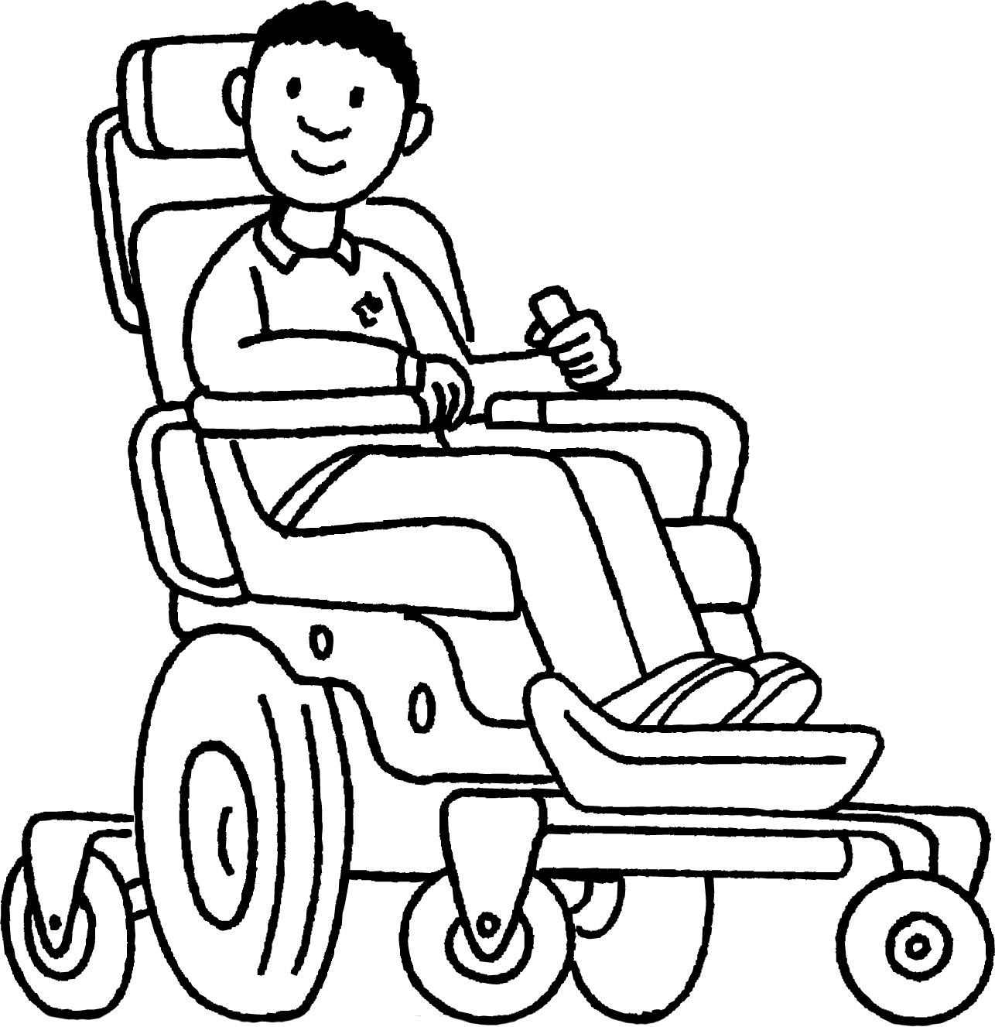
What is sustainability?
Did you explain what sustainability means to you?
I made a poster to put up in the classroom. It said:
Sustainability is about meeting the needs of today without preventing future generations from doing the same.

Slide 15
Introducing sustainability
What is sustainability?
Why is there a need for sustainability?
Do our choices matter?

Slide 16
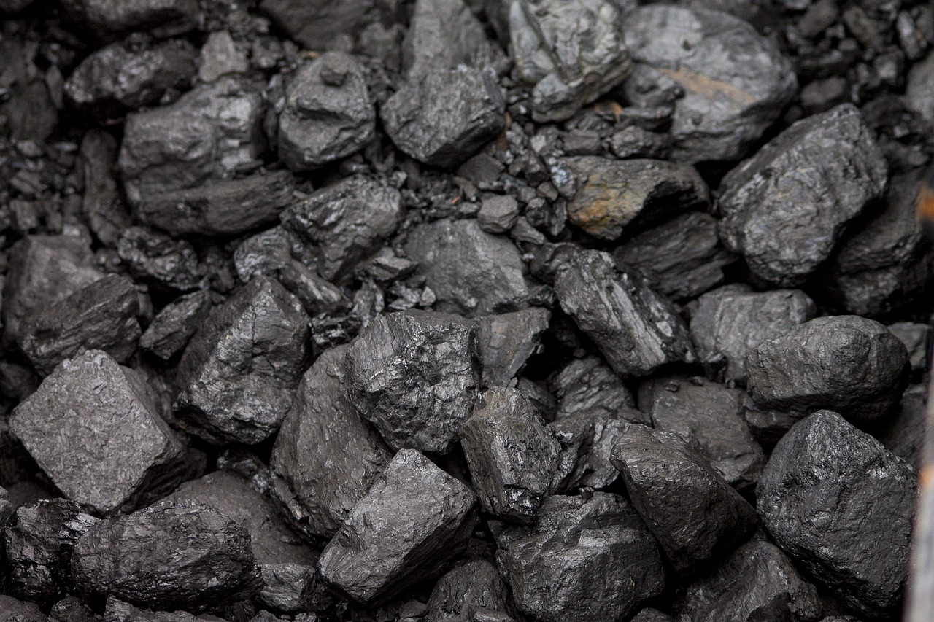
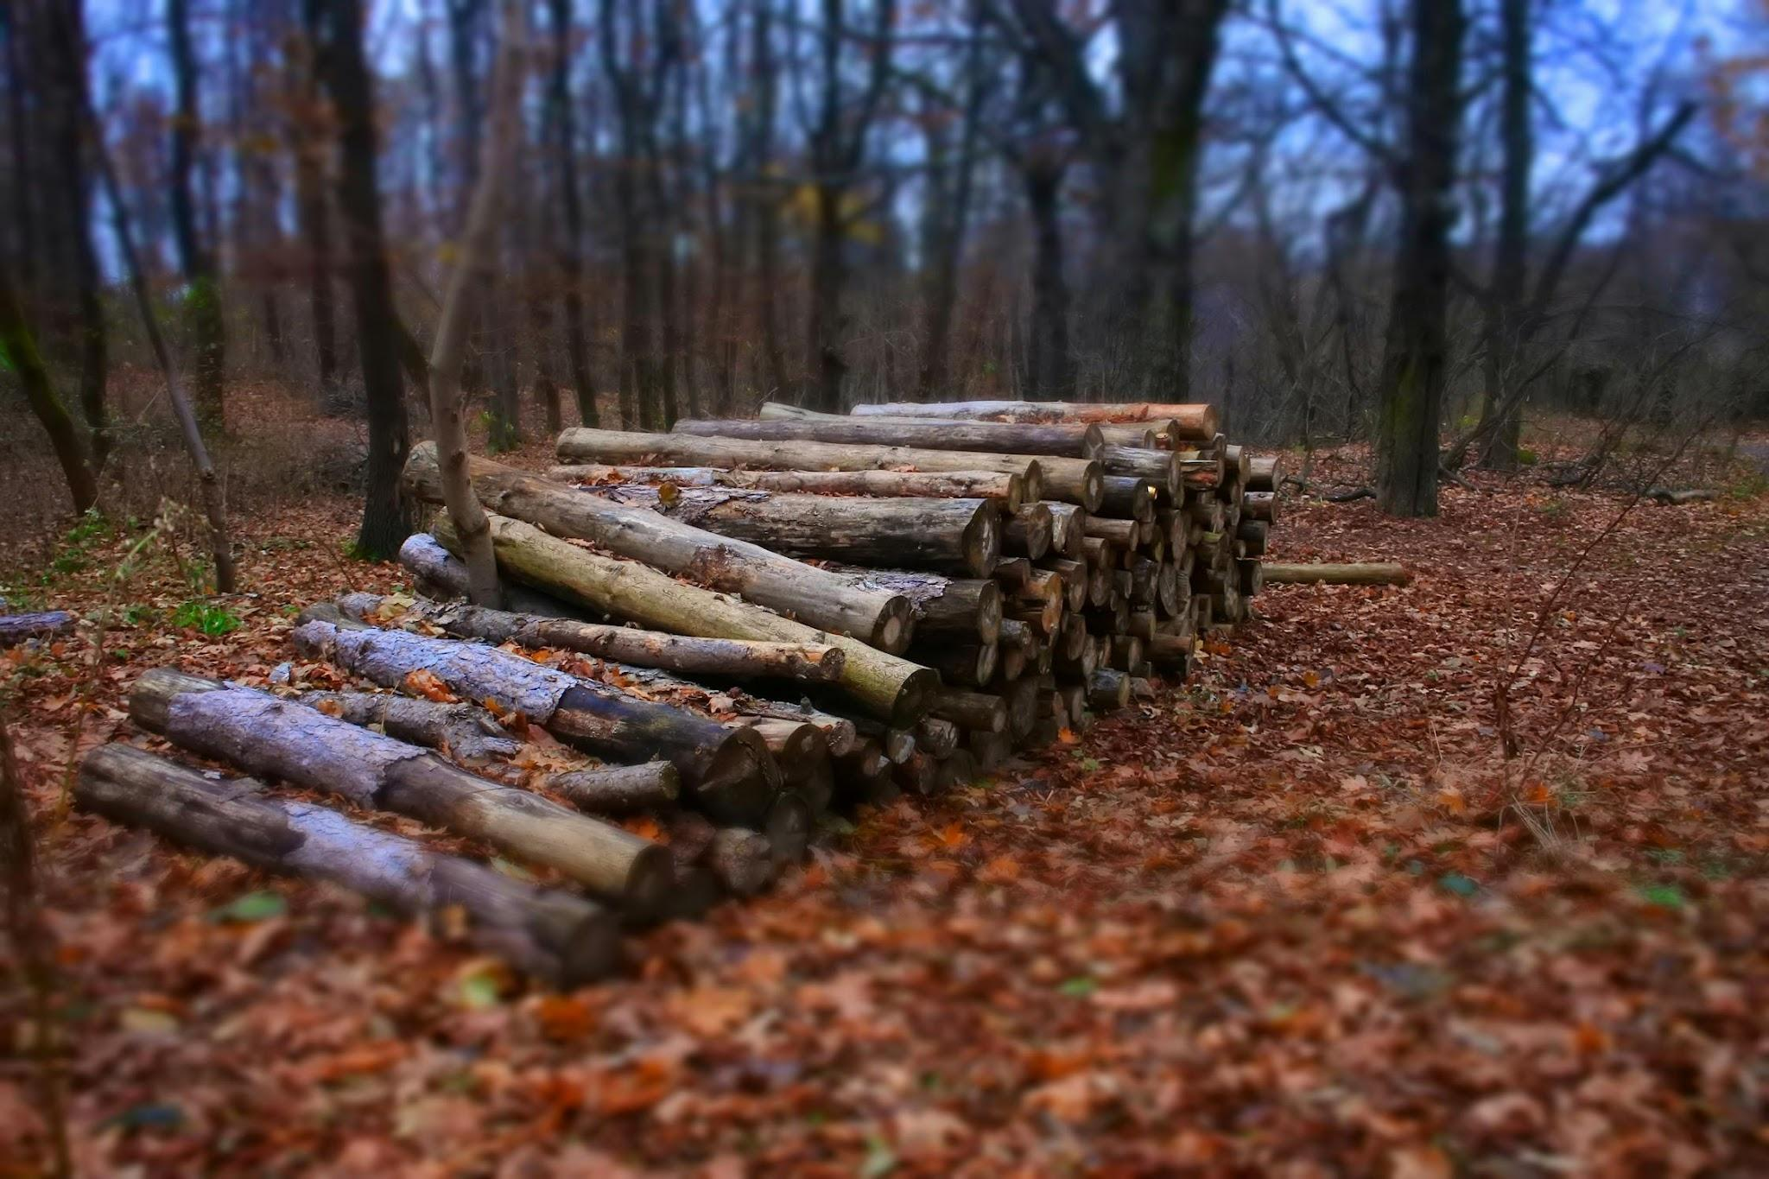
Why is there a need for sustainability?
Natural resources can be renewable like water and wood or non-renewable like the fossil fuels coal, oil and natural gas.
Non-renewable resources are finite and will eventually run out.
non-renewable
renewable

Slide 17
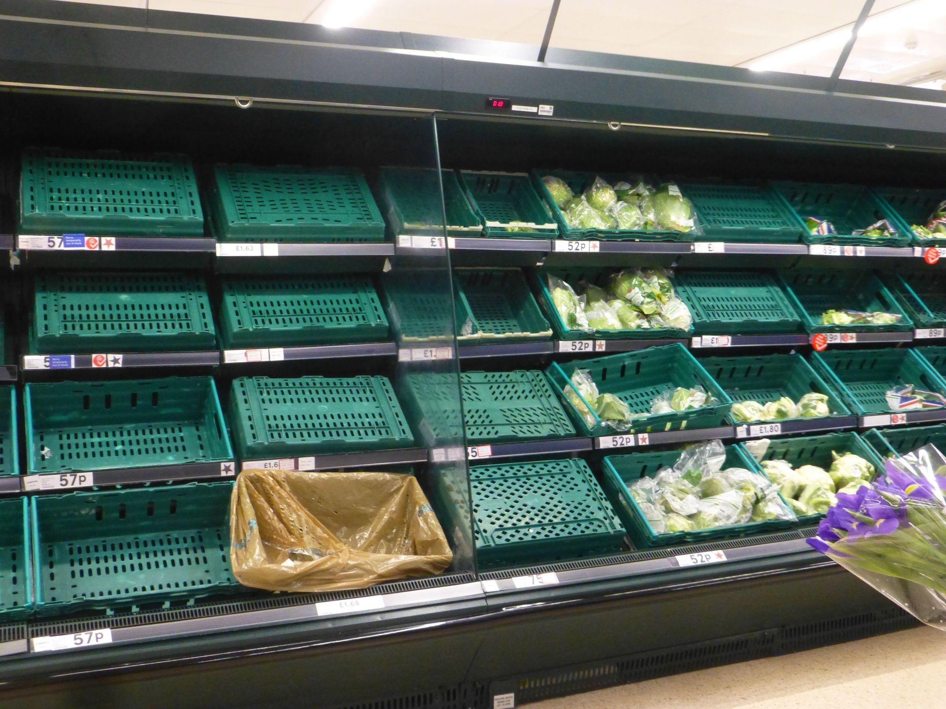
Why is there a need for sustainability?
If we run out of the resources that we need, or use them up too quickly, then we will experience shortages of essential resources for food, water and energy.

Slide 18
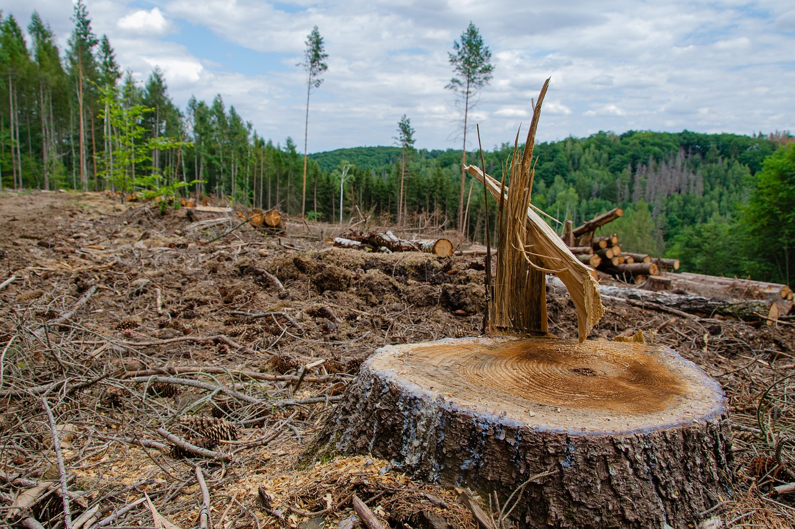
Why is there a need for sustainability?
If we use these natural resources sustainably today
then they will still be available in the future. We as humans need to be careful. Even renewable resources could be exhausted or damaged beyond use if they are not used sustainably.
Are natural resources being used sustainably?
For example, what would happen if all of the trees in this photo were cut down?

Slide 19

Why is there a need for sustainability?
“Humans use as many ecological resources as if we lived on almost two Earths.”
World Wildlife Fund, 2022
Photos: ixpert/Shutterstock.com

Slide 20
Why is there a need for sustainability?
Human demand and natural resources are unevenly distributed across the Earth.
There is great inequality about who gets what, where, when and why.
The average person in a rich country consumes up to 10 times more natural resources than the average person in the poorest countries.
Friends of the Earth, 2009
There are also inequalities within countries. Some people in rich countries may not consume many resources at all while some people in poorer countries may consume a lot of resources.

Slide 21
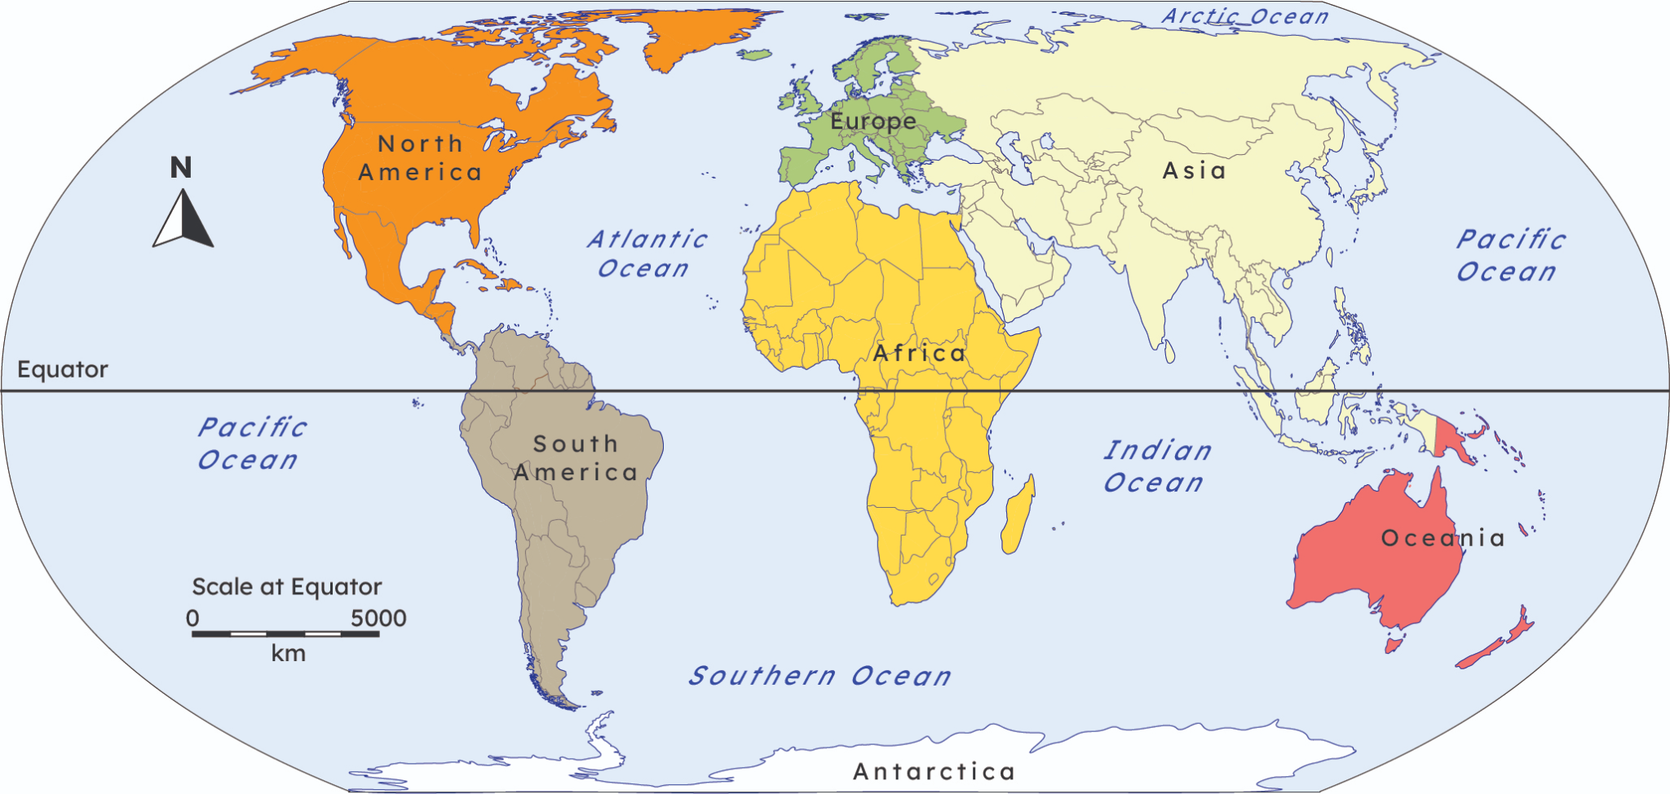
Why is there a need for sustainability?
On average, an inhabitant of a wealthy continent like North America consumes around 90 kilograms (kg) of resources each day.
While in Africa, on average people consume only around 10 kg per day.

Slide 22
Why is there a need for sustainability?
If everyone lived like wealthy people in the richer parts of the world, then we would be using the resources of even more than two planets.
If everyone lived like the least wealthy people in the poorer parts of the world, we would be using the resources of less than one planet.
Photos: ixpert/Shutterstock.com

Slide 23
Why is there a need for sustainability?
Who consumes the most natural resources?
most people living in poor countries
everyone consumes the same amount
wealthy families living in rich countries

Slide 24
Why is there a need for sustainability?
Complete the paragraph using words from the word bank.
‘Sustainability’ can be defined as meeting the needs of today without preventing ___________ from doing so. The Earth is a beautiful planet that contains all the ___________ that humans need for life - shelter, warmth and food. Human demand and natural resources are __________ shared across the Earth. Most people in rich countries __________ up to 10 times more natural resources than most of those in the poorest countries.
consume unevenly natural resources future generations

Slide 25
Why is there a need for sustainability?
Did you correctly complete the paragraph?
‘Sustainability’ can be defined as meeting the needs of today
without preventing ___________ from doing so. The Earth is a beautiful planet that contains all the ___________ that humans need for life - shelter, warmth and food. Human demand and natural resources are __________ shared across the Earth. Most people in rich countries __________ up to 10 times more natural resources than most of those in the poorest countries.
future generations
natural resources
unevenly
consume

Slide 26
Introducing sustainability
What is sustainability?
Why is there a need for sustainability?
Do our choices matter?

Slide 27

Do our choices matter?
The choices that we make have consequences. These can affect people, places and the environment at a local or global level.
Can you think of some choices that you have made today?

Slide 28




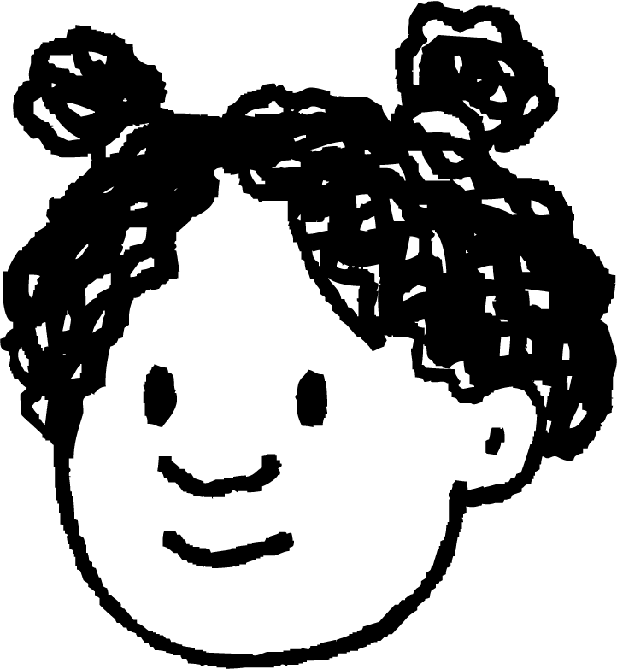
Do our choices matter?
Which things can we choose?
What I spend my pocket money on.
What I do when I get home from school.
What I eat.
Who I play with.

Slide 29
Do our choices matter?
We have some power to act on our choices about where we go, how we get there, what we eat and what we do. Our choices have consequences. These can have a local or even global impact.
I walked home from school so I saved petrol, a natural resource.
I ate all of my lunch so no food was wasted.

Slide 30
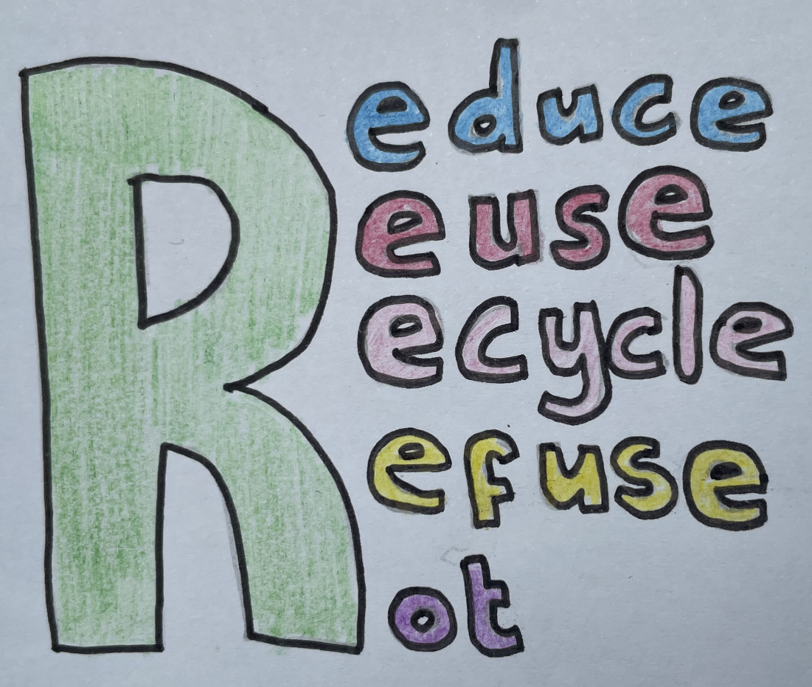
Do our choices matter?
We need to be aware of consuming too many natural resources. Instead of wasting valuable resources we can reduce, reuse and recycle them.
We can all work to improve sustainability through our choices.

Slide 31
Do our choices matter?
Do our choices affect global sustainability?
Yes - we have the power to do some things that will positively affect the future.
No - the outcome of global sustainability is already decided.
No - we are just individuals, our choices make a tiny difference that can’t have a global impact.

Slide 32
Do our choices matter?
Record the choices that you had to make yesterday, what your decision was and what the consequences were. Look at the example for some ideas.
Choice | Decision | Consequence
How should I travel to school? | On my scooter | I saved petrol by scooting but I got wet because it rained.

Slide 33
Do our choices matter?
Choice | Decision | Consequence
How should I travel to school? | On my scooter | I saved petrol by scooting but I got wet because it rained.
What should I have for lunch? | Cheese and tomato pizza | The cook used ingredients to make this for me and my family had to pay for it.
Who shall I play with? | My friends Laura and Jun | We all had a fun playtime but I didn’t have time to see my little brother.
What should I do after school? | Play on my games console | I reached a new level but I used some electricity and forgot to do my homework!

Slide 34
Introducing Sustainability
Sustainability is about meeting the needs of today without preventing people being able to do so in the future
There is great inequality about who can get what, where, when and why
We have some power to make - and act on - choices about where we go, how we get there, what we eat and what we do

Slide 35

© Oak National Academy 2024.
Produced in partnership with The Geographical Association.
Licensed on the Open Government Licence v3.0, except where otherwise stated. See Oak terms and conditions.

