Slide 1
Explain how to multiply a 3-digit number by a 2-digit number
Multiplying and dividing by 2-digit numbers

Slide 2
How our teaching resources are designed for the classroom

Slide 3
I can explain how to multiply a 3-digit number by a 2-digit number.

Slide 4
partial product

Slide 5
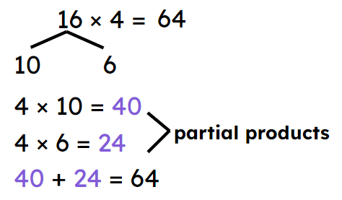
Any of the multiplication results we get leading up to an overall multiplication result is a partial product.
10
6
4 tens
24 ones
4 tens
24 ones
4
product

Slide 6

Explain how to multiply a 3-digit number by a 2-digit number
Multiply 2-digit numbers by 2-digit numbers
Multiply 3-digit numbers by 2-digit numbers

Slide 7

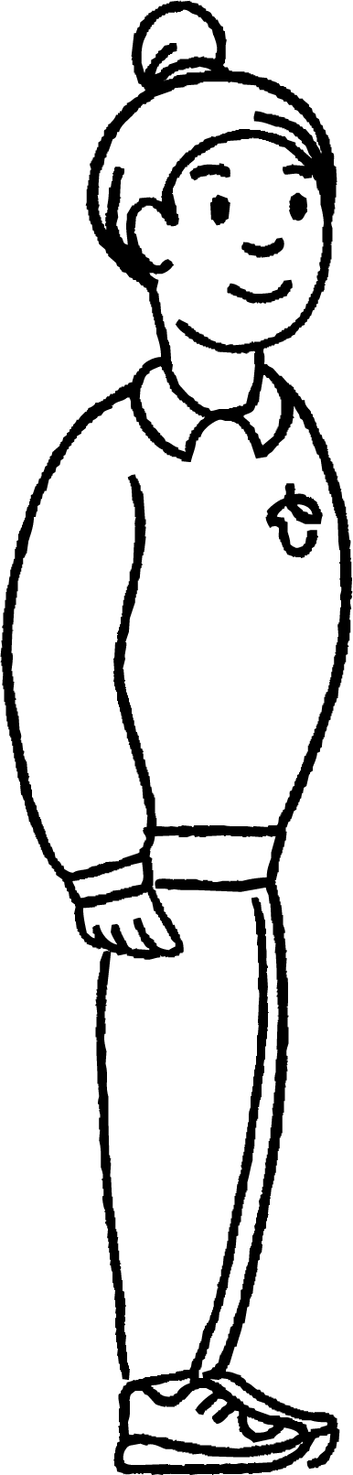
Multiply 2-digit numbers by 2-digit numbers
In this lesson you will meet:
Sam
Andeep

Slide 8
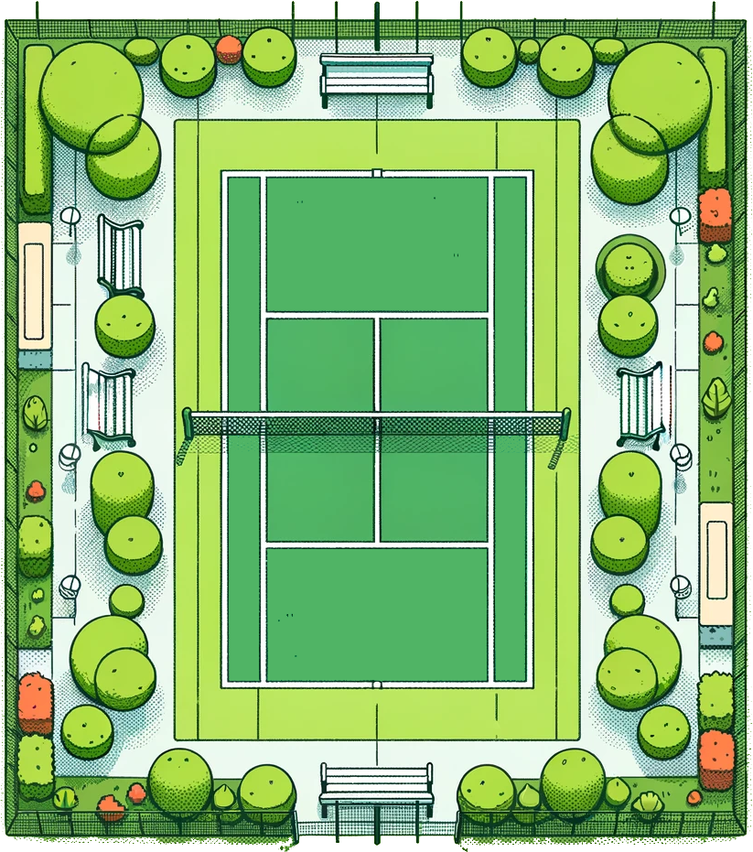
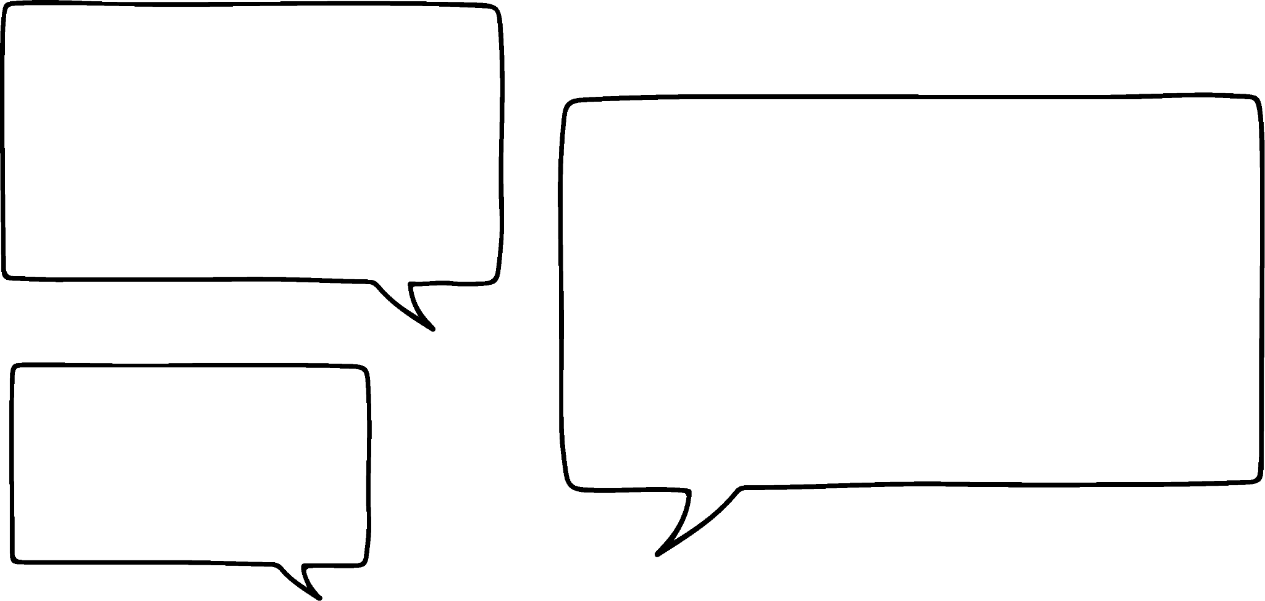


Multiply 2-digit numbers by 2-digit numbers
Sam and Andeep go to watch a tennis match. They think about how many people are in their section of the stands.
I can see seats in rows of 31
If there are 29 rows, how many seats would that be altogether?
31 × 29 = ___

Slide 9
Multiply 2-digit numbers by 2-digit numbers
They show the calculation using a grid or area model.
20 rows
31 × 20
29 rows
31 × 29
9 rows
31 × 9
31 in each row
31 in each row

Slide 10
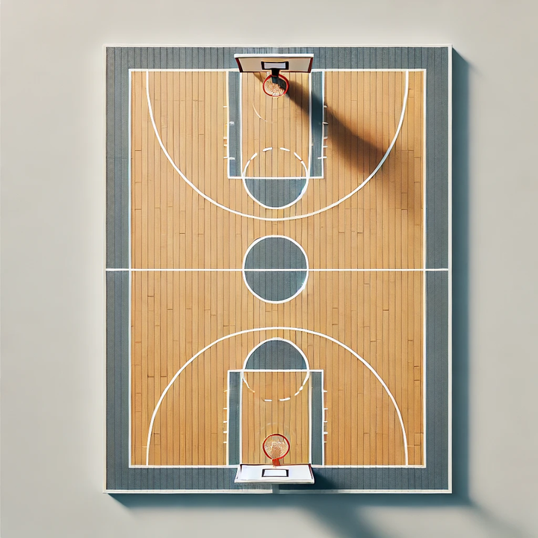
Multiply 2-digit numbers by 2-digit numbers
The next weekend, they go to watch a basketball game.
I can see seats in rows of 43
If there are 32 rows how many seats would that be altogether?
43 × 32 = ___

Slide 11
Multiply 2-digit numbers by 2-digit numbers
You can use a grid model to show your thinking.
30 rows
43 × 30
32 rows
43 × 32
2 rows
43 × 2
43 in each row
43 in each row

Slide 12



Multiply 2-digit numbers by 2-digit numbers
Which representation below represents the equation: 55 × 15 ?
How do you know? Explain your thinking to your partner.
15 rows
10 rows
55 × 10
15 × 55
5 rows
55 × 5
55 in each row
55 in each row
Both represent the equation: 55 × 15
a
b

Slide 13
Multiply 2-digit numbers by 2-digit numbers
A part-part-whole model can represent the strategy for calculation.
31 × 29
31 × 20
20
31 × 20
31 × 9
31 × 9
9
31
To find the product we can calculate 20 groups of 31 and 9 groups of 31
These are partial products.

Slide 14
Multiply 2-digit numbers by 2-digit numbers
31 × 29
31 × 20
20
31 × 20
31 × 9
31 × 9
9
 | 3 | 1 |  |  | 3 | 1 |  |  |  | 6 | 2 | 0
 | 2 | 0 | × |  |  | 9 | × |  |  | 2 | 7 | 9 | +
6 | 2 | 0 |  | 2 | 7 | 9 |  |  |  | 8 | 9 | 9
31

Slide 15
Multiply 2-digit numbers by 2-digit numbers
899
620
20
620
279
279
9
31
31 × 29 = 899
There were 899 seats in the section of the tennis court.

Slide 16
Multiply 2-digit numbers by 2-digit numbers
Let’s return to the basketball court.
43 × 22
43 × 20
20
43 × 2
2
43 × 20
43 × 2
43
 | 4 | 3 |  |  | 4 | 3 |  |  |  | 8 | 6 | 0
 | 2 | 0 | × |  |  | 2 | × |  |  |  | 8 | 6 | +
8 | 6 | 0 |  |  | 8 | 6 |  |  |  | 9 | 4 | 6

Slide 17
Multiply 2-digit numbers by 2-digit numbers
Let’s return to the basketball court.
946
860
20
86
2
860
86
43
22 × 43 = 946
There were 946 seats in the section of the basketball court.

Slide 18
Multiply 2-digit numbers by 2-digit numbers
Use partitioning to fill in the missing expressions.
45 × 18
45 × 18
45 × 10
45 × 8

Slide 19
Multiply 2-digit numbers by 2-digit numbers
1) Represent the expressions using a grid model. You do not need to calculate the product.
15 × 26
25 × 17
a)
b)
c)
32 × 24
d)
46 × 27

Slide 20
Multiply 2-digit numbers by 2-digit numbers
2) Look at the grid and part-part-whole models below. Use information from each to fill in the blanks and calculate the products.
___ × ___
a)
35 × 12
? × 10
10
35 × ?
?
35 × ?
35 × ?
?
___ × ___
b)
? × ?
? × 10
?
? × 7
?
? × 10
? × 7
43

Slide 21
Multiply 2-digit numbers by 2-digit numbers
1) Look at the following multiplication equations. Represent these using a grid model. You do not need to calculate the equation.
15 × 26
25 × 17
a)
b)
26 × 10
10
25 × 10
10
26 × 5
5
25 × 7
7
26
25
c)
32 × 24
d)
46 × 27
32 × 20
20
46 × 20
20
32 × 4
4
46 × 7
7
32
46

Slide 22
Multiply 2-digit numbers by 2-digit numbers
2) Look at the grid and part-part-whole models below. Use information from each to fill in the blanks and calculate the answers.
35 × 12
a)
35 × 12
35 × 10
10
35 × 2
2
35 × 10
35 × 2
35
43 × 17
b)
43 × 17
43 × 10
10
43 × 7
7
43 × 10
43 × 7
43

Slide 23
Multiply 2-digit numbers by 2-digit numbers
2) Look at the grid and part-part-whole models below. Use information from each to fill in the blanks and calculate the answers.
35 × 12
a)
 | 3 | 5 |  |  | 3 | 5 |  |  |  | 3 | 5 | 0
 | 1 | 0 | × |  |  | 2 | × |  |  |  | 7 | 0 | +
3 | 5 | 0 |  |  | 7 | 0 |  |  |  | 4 | 2 | 0
35 × 10
35 × 2
1
 | 4 | 3 |  |  | 4 | 3 |  |  |  | 4 | 3 | 0
 | 1 | 0 | × |  |  | 7 | × |  |  | 3 | 0 | 1 | +
4 | 3 | 0 |  | 3 | 0 | 1 |  |  |  | 7 | 3 | 1
b)
43 × 17
43 × 10
43 × 7
2

Slide 24
Explain how to multiply a 3-digit number by a 2-digit number
Multiply 2-digit numbers by 2-digit numbers
Multiply 3-digit numbers by 2-digit numbers

Slide 25
Multiply 3-digit numbers by 2-digit numbers
At a tennis event, a stall stocks 232 bottles of water on one set of shelves. If it has 17 full shelves, how many bottles of water does it have to sell?
You can use a grid model to show your thinking.
10 shelves
232 × 10
17 shelves
232 × 17
7 shelves
232 × 7
232 on each shelf
232 in each shelf
Notes:
To make multiplying easier, we can partition the smaller number.

Slide 26
Multiply 3-digit numbers by 2-digit numbers
You can also use the part- part-whole model to show your thinking.
232 × 17
232 × 10
10
232 × 7
7
232 × 10
232 × 7
232
 | 2 | 3 | 2 |  |  | 2 | 3 | 2 |  |  | 2 | 3 | 2 | 0
 |  | 1 | 0 | × |  |  |  | 7 | × |  | 1 | 6 | 2 | 4 | +
2 | 3 | 2 | 0 |  | 1 | 6 | 2 | 4 |  |  | 3 | 9 | 4 | 4

Slide 27

Multiply 3-digit numbers by 2-digit numbers
Andeep has represented 245 × 33
Is he correct? Justify your thinking to your partner.
Andeep has partitioned 33 incorrectly. The grid should show 30 and 3
245 × 33
33
245 × 3
3
245

Slide 28
Multiply 3-digit numbers by 2-digit numbers
1) Answer the following questions below - draw a grid model each time to show how you would partition the calculation.
a) 323 × 23 =
b) 431 × 22 =
c) 204 × 34 =
d) 420 × 12 =
e) 389 × 12 =

Slide 29
Multiply 3-digit numbers by 2-digit numbers
1) Answer the following questions below - draw a grid model each time to show how you would partition the calculation.
a) 323 × 23 = 7,429
b) 431 × 22 = 9,482
 | 3 | 2 | 3 |  |  | 3 | 2 | 3 |  |  | 6 | 4 | 6 | 0
 |  | 2 | 0 | × |  |  |  | 3 | × |  |  | 9 | 6 | 9 | +
6 | 4 | 6 | 0 |  |  | 9 | 6 | 9 |  |  | 7 | 4 | 2 | 9
323 × 20
20
323 × 3
3
323
1
1
 | 4 | 3 | 1 |  |  | 4 | 3 | 1 |  |  | 8 | 6 | 2 | 0
 |  | 2 | 0 | × |  |  |  | 2 | × |  |  | 8 | 6 | 2 | +
8 | 6 | 2 | 0 |  |  | 8 | 6 | 2 |  |  | 9 | 4 | 8 | 2
431 × 20
20
431 × 2
2
1
431

Slide 30
Multiply 3-digit numbers by 2-digit numbers
c) 204 × 34 = 6,936
d) 420 × 12 = 5,040
 | 2 | 0 | 4 |  |  | 2 | 0 | 4 |  |  | 6 | 1 | 2 | 0
 |  | 3 | 0 | × |  |  |  | 4 | × |  |  | 8 | 1 | 6 | +
6 | 1 | 2 | 0 |  |  | 8 | 1 | 6 |  |  | 6 | 9 | 3 | 6
204 × 30
30
204 × 4
4
204
 | 4 | 2 | 0 |  |  | 4 | 2 | 0 |  |  | 4 | 2 | 0 | 0
 |  | 1 | 0 | × |  |  |  | 2 | × |  |  | 8 | 4 | 0 | +
4 | 2 | 0 | 0 |  |  | 8 | 4 | 0 |  |  | 5 | 0 | 4 | 0
420 × 10
10
420 × 2
2
1
420

Slide 31
Multiply 3-digit numbers by 2-digit numbers
e) 389 × 12 = 4,668
 | 3 | 8 | 9 |  |  | 3 | 8 | 9 |  |  | 3 | 8 | 9 | 0
 |  | 1 | 0 | × |  |  |  | 2 | × |  |  | 7 | 7 | 8 | +
3 | 8 | 9 | 0 |  |  | 7 | 7 | 8 |  |  | 4 | 6 | 6 | 8
389 × 10
10
389 × 2
2
389
1
1
1
1

Slide 32
Explain how to multiply a 3-digit number by a 2-digit number
We can use informal methods of multiplication to calculate the the product.
We can do this by partitioning one of the factors, calculating the partial products and then adding the partial products to recombine.

Slide 33

© Oak National Academy 2024.
Produced in partnership with Mathematics in Education and Industry.
Licensed on the Open Government Licence v3.0, except where otherwise stated. See Oak terms and conditions.

