Slide 1
Multiply a 3-digit by a 1-digit number with no regroups
Multiplication by partitioning leading to short multiplication (3 by 1-digit)

Slide 2
I can multiply a 3-digit by a 1-digit number using expanded and short multiplication (no regroups).

Slide 3
expanded multiplication
short multiplication
factors

Slide 4
Expanded multiplication is a way of recording the steps of a calculation focusing on partitioning one or more factors and showing partial products.
A way of recording using columns to set out and calculate a multiplication is called short multiplication.

Slide 5
Numbers we can multiply together to get another number are known as factors.
2 × 3 = 6
factor
factor

Slide 6

Multiply a 3-digit by a 1-digit number with no regroups
Understanding and applying expanded multiplication
Understanding and applying short multiplication

Slide 7
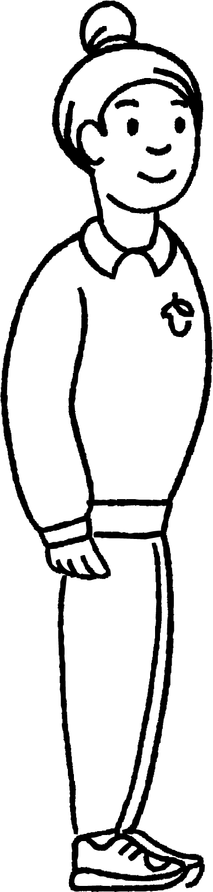
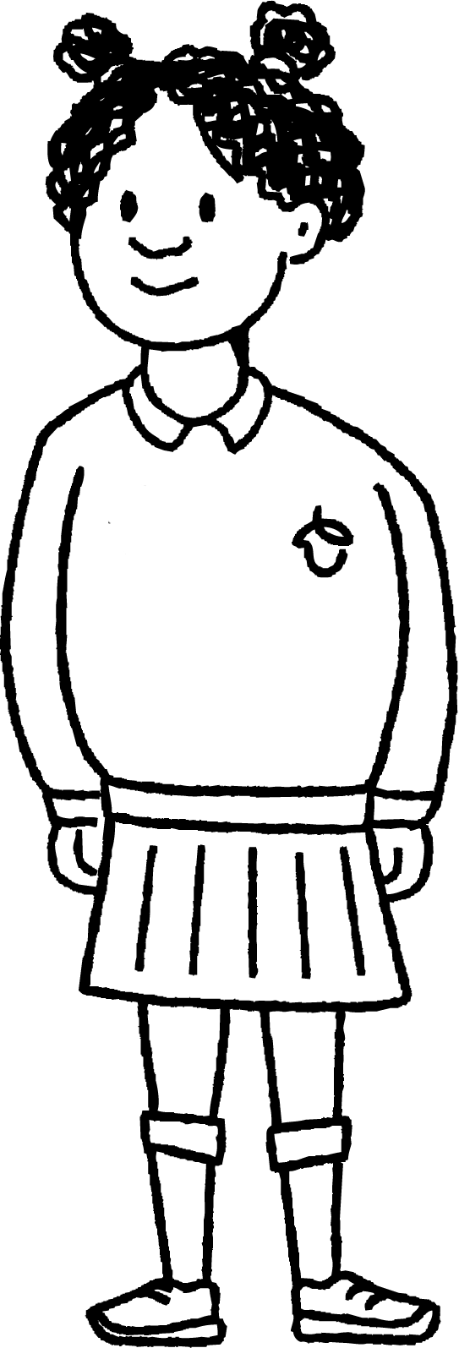
Understanding and applying expanded multiplication
In this lesson you will meet:
Andeep
Izzy

Slide 8
Understanding and applying expanded multiplication
10s 1s
You may have seen this:
4
3
×
2
Expanded multiplication
6
8
0
8
6
Today we will explore how to use expanded multiplication when multiplying a 3-digit by a 1-digit number.

Slide 9

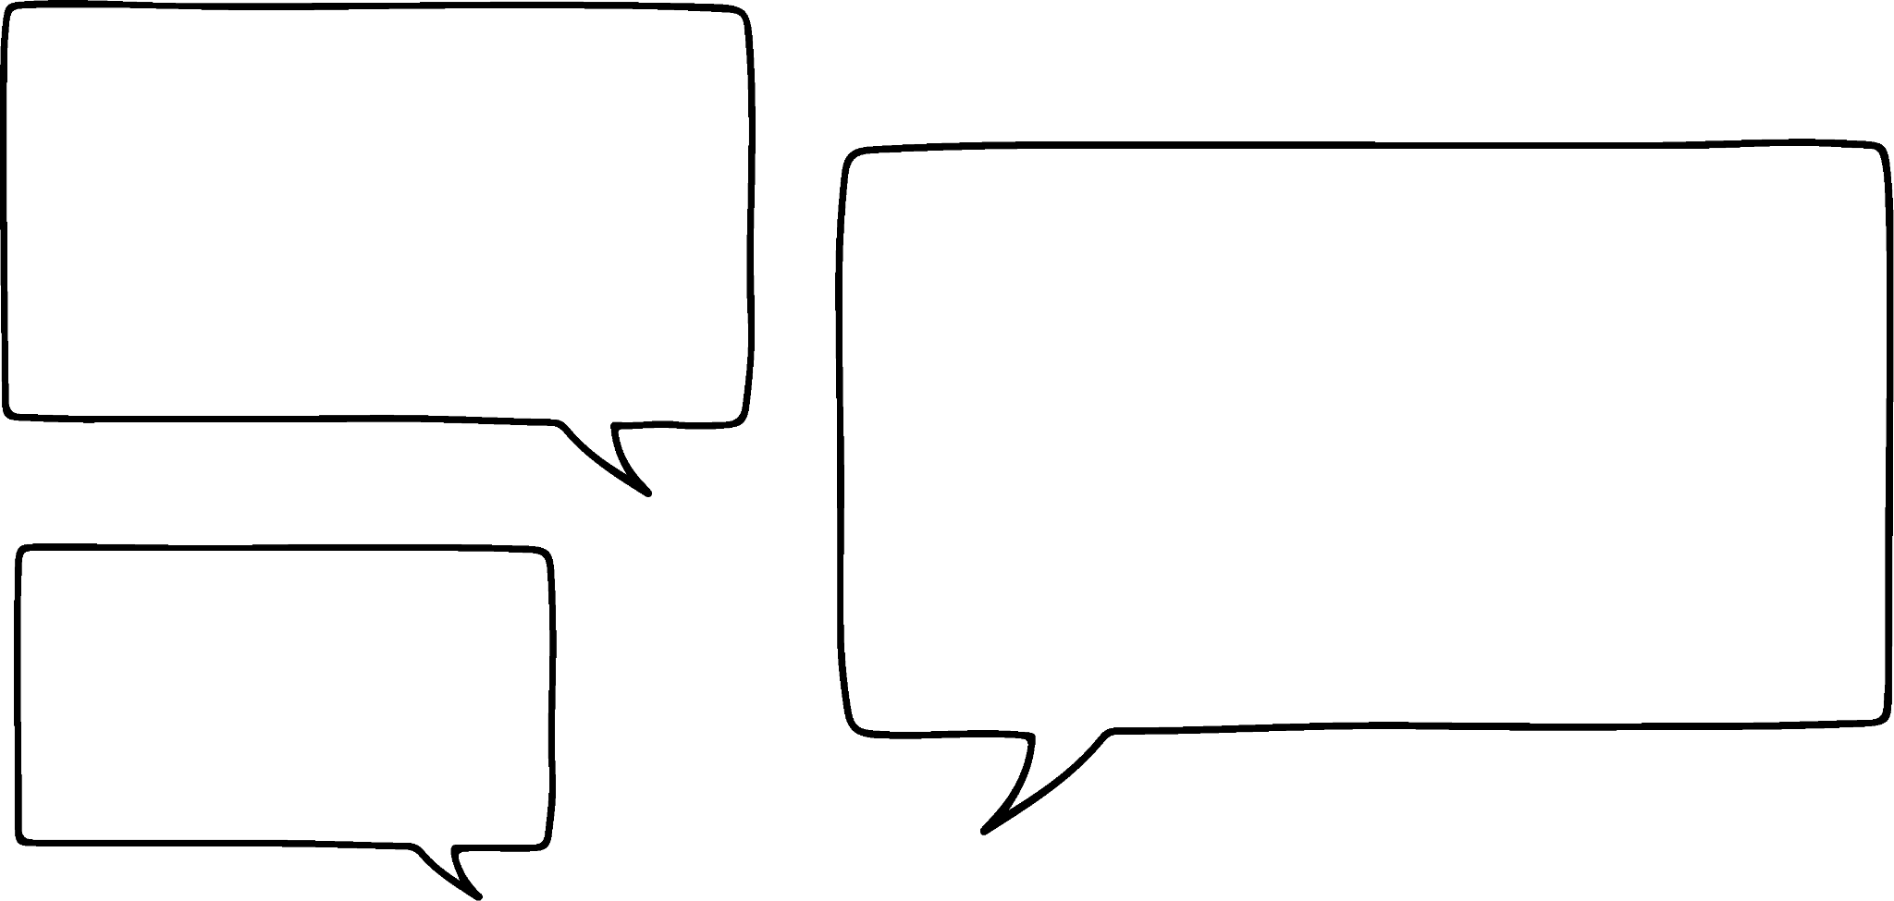

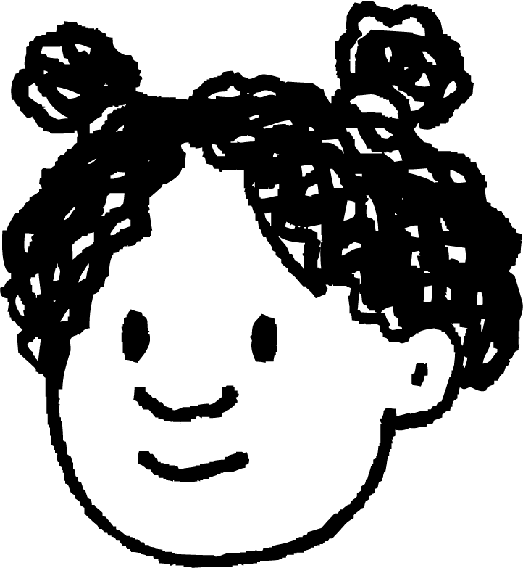
Understanding and applying expanded multiplication
Two laptops cost £322 each. What is the total cost?
I can use expanded multiplication.
I am going to use base ten blocks to help me.
What is the multiplication equation needed?

Slide 10
Understanding and applying expanded multiplication
322 × 2
100s
10s 1s
3
2
2
×
2
Partition 322 into 3 hundreds 2 tens and 2 ones.
Then, place the smaller factor in the ones column.
The smaller factor here is 2.
You can record multiplication using expanded multiplication.
First place the largest factor at the top.

Slide 11
Understanding and applying expanded multiplication
322 × 2
100s
10s 1s
3
2
2
×
2
4
2 × 2 ones = 4 ones
4
0
2 × 2 tens = 4 tens
6
0
0
2 × 3 hundred = 6 hundred
Place the 4 underneath the tens column and 0 as a placeholder in the ones column.
Place the 6 underneath the hundreds column and put 0 as a place holder in the tens and ones column.
Next move onto the hundreds column.
Multiply the ones.
Write the 4 in the ones column.
Next move on to the tens column.
Multiply the tens.

Slide 12
Understanding and applying expanded multiplication
322 × 2
100s
10s 1s
3
2
2
×
2
4
4
0
6
0
0
6
4
4
Now add the partial products.
6 hundred add 4 tens add 4 ones is equal to 644

Slide 13
Understanding and applying expanded multiplication
322 × 2
100s
10s 1s
3
2
2
×
2
4
4
0
6
0
0
6
4
4

Slide 14



Understanding and applying expanded multiplication
Choose the correct expanded multiplication record for this representation:
100s
10s 1s
100s
10s 1s
2
1
1
2
1
1
×
2
×
3

Slide 15
Understanding and applying expanded multiplication
Andeep and Izzy have used two different ways to record.
What’s the same?
What’s different?
Expanded multiplication
100s
10s 1s
Informal written
3
2
2
322 × 2 = 2 × 300
+ 2 × 20
+ 2 × 2
×
2
= 600 + 40 + 4
4
= 644
4
0
6
0
0
I still got the same answer.
6
4
4

Slide 16
Understanding and applying expanded multiplication
Andeep and Izzy have used two different ways to record.
What’s the same?
Expanded multiplication
Informal written
100s
10s 1s
322 × 2 = 2 × 300
+ 2 × 20
+ 2 × 2
3
2
2
= 600 + 40 + 4
×
2
= 644
4
4
0
6
0
0
Partial products are recorded and combined.
6
4
4

Slide 17
Understanding and applying expanded multiplication
Andeep and Izzy have used two different ways to record.
What’s different?
Expanded multiplication
Informal written
100s
10s 1s
322 × 2 = 2 × 300
+ 2 × 20
+ 2 × 2
3
2
2
= 600 + 40 + 4
×
2
= 644
4
When using the informal written method, we begin by multiplying our hundreds, then tens, then ones.
4
0
When using expanded multiplication, we begin by multiplying our ones, then tens, then hundreds.
6
0
0
6
4
4

Slide 18
Understanding and applying expanded multiplication
Using Andeep’s informal recording, fill in the gaps for Izzy’s expanded multiplication recording.
100s
10s 1s
3
2
___
___
___
3
323 × 2 = 2 × 300
+ 2 × 20
+ 2 × 3
×
___
2
= 600 + 40 + 6
6
= 646
___
___
___
4
0
___
___
___
6
0
0
___
___
___
6
4
6

Slide 19
Understanding and applying expanded multiplication
Label the expanded multiplication examples below:
100s
10s 1s
100s
10s 1s
3
2
2
3
2
2
__________
×
2
×
2
4
4
4
0
4
0
__________
6
0
0
6
0
0
__________
6
4
4
6
4
4

Slide 20
Understanding and applying expanded multiplication
2) Record the calculation of these multiplication equations using expanded multiplication.
122 × 4
3 × 131
323 × 3

Slide 21
Understanding and applying expanded multiplication
Label the expanded multiplication examples below:
100s
10s 1s
100s
10s 1s
3
2
2
3
2
2
factors
×
2
×
2
4
4
4
0
4
0
partial products
6
0
0
6
0
0
product
6
4
4
6
4
4

Slide 22
Understanding and applying expanded multiplication
2)Record the calculation of these multiplication equations using expanded multiplication.
122 × 4
3 × 131
323 × 3
100s
10s 1s
100s
10s 1s
100s
10s 1s
1
2
2
1
3
1
3
2
3
×
4
×
3
×
3
8
3
9
8
0
9
0
6
0
4
0
0
3
0
0
9
0
0
4
8
8
3
9
3
9
6
9

Slide 23
Multiply a 3-digit by a 1-digit number with no regroups
Understanding and applying expanded multiplication
Understanding and applying short multiplication

Slide 24
Understanding and applying short multiplication
You may have seen this:
2 3
I can use short multiplication.
×
2
6
4
Today we will learn how to use short multiplication when multiplying a 3-digit by a 1-digit number.

Slide 25
Understanding and applying short multiplication
Two laptops cost £322 each. What is the total cost?
I can use short multiplication.
I am going to use base ten blocks to help me.
What is the multiplication equation needed?

Slide 26
Understanding and applying short multiplication
You can use short multiplication to multiply a 3-digit by a 1-digit number.
322 × 2
3
2
2
I need 2 groups of 322
×
Because you are multiplying by a factor that has 3 digits, you now have a digit in the hundreds column.
The largest factor goes at the top.
What do you notice?
First partition 322 into 3 hundreds, 2 tens and 2 ones.

Slide 27
Understanding and applying short multiplication
You can use short multiplication to multiply a 3-digit by a 1-digit number.
322 × 2
3
2
2
×
2
4
2 × 2 ones is equal to 4 ones.
Next, place the smallest factor underneath the ones column.
Now, multiply starting with the ones.
Write 4 in the ones column.

Slide 28
Understanding and applying short multiplication
322 × 2 =
322 × 2
3
2
2
×
2
6
4
4
The product is 644
2 × 3 hundreds is equal to 6 hundreds.
2 × 2 tens is equal to 4 tens
Then move to the tens column.
Write ‘4’ in the tens column.
Two laptops cost £644
Next, move on to the hundreds column.
Write ‘6’ in the hundreds column.
6 hundreds add 4 tens add 4 ones is equal to 644

Slide 29
Understanding and applying short multiplication
The product is 339. Which short multiplication shows this correctly?
1
1
3
1
1
3
3
3
9
×
3
×
3
×
3
3
3
9
3
3
9
1
1
3

Slide 30
Understanding and applying short multiplication
Andeep is calculating 113 × 3. What is wrong with this calculation?
1
1
3
×
3
3
3
9
Andeep has not aligned his smaller factor correctly.
Andeep is multiplying by 3 ones, so should have placed the 3 in the ones column.

Slide 31
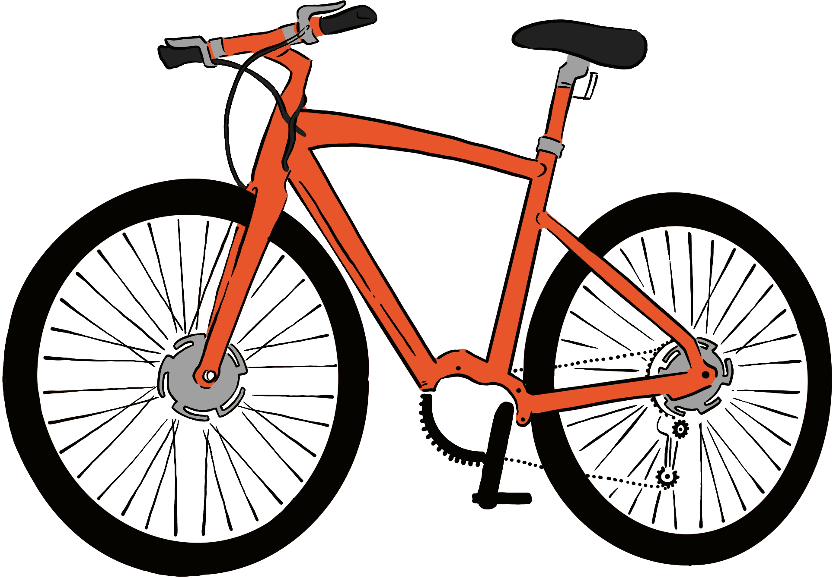
Understanding and applying short multiplication
One bike costs £122.
One month later it costs three times as much.
What is the new cost?
£122
What multiplication equation is needed ?

Slide 32
Understanding and applying short multiplication
122 × 3
1
2
2
3 × 2 ones is equal to 6 ones.
3 × 2 tens is equal to 6 tens.
3 × 1 hundred is equal to 3 hundreds.
The product is 366.
×
3
3
6
6
Then place the smallest factor underneath in the ones column.
First place the largest factor at the top.
Now, multiply starting with the ones.
Write ‘6’ in the ones column.
Next, move onto the tens column.
Write ‘6’ in the tens column.
Then, move onto the hundreds column.
Write ‘3’ in the hundreds column.

Slide 33
Understanding and applying short multiplication
If the factors are 130 and 2, which short multiplication method is correct?
1
3
0
1
0
3
1
3
0
×
2
×
2
×
2
2
6
0
2
0
6
2
6
0

Slide 34
Understanding and applying short multiplication
Numbers from Sofia’s calculations rubbed off.
What could the missing number be?
I can use my times tables facts to help me.
1
1
2
×
3
3
3
6
What is known?
What is unknown?

Slide 35
Understanding and applying short multiplication
Numbers from Sofia’s calculations rubbed off.
What could the missing number be?
1
1
2
Something multiplied by 3 ones gives me 6 ones…
2
×
3
3
3
6
1 × 3 = 3
2 × 3 = 6
Start by looking at the ones column.
Put 2 in the ones column.

Slide 36

Understanding and applying short multiplication
What is the missing number?
1
2
2
1 3
I will look at the ones column first to help me.
×
4
×
3
3 9
4
8
8
Explain your thinking to your partner.

Slide 37
Understanding and applying short multiplication
Explain how you know to your partner.
What are the missing numbers?
1
2
4
1 3
I will look at the tens column to help me.
×
2
×
3
3 9
2
4
8

Slide 38
Understanding and applying short multiplication
Use short multiplication to record and calculate these equations:
a)
442 × 2 =
b)
c)
321 × 3 =
4 × 212 =
Fill in the gaps:
3
2
1
1
3
×
3
×
4
×
2
9
6
9
8
4
0
2
6
8

Slide 39

Understanding and applying short multiplication
Complete the word problem using short multiplication. If all these boxes are the same height, how tall is the stack of boxes?
221 cm

Slide 40
Understanding and applying short multiplication
Use short multiplication to record and calculate these equations:
a)
442 × 2 =
321 × 3 =
4 × 212 =
b)
c)
4
4
2
3
2
1
2
1
2
×
2
×
3
×
4
8
8
4
9
6
3
8
4
8

Slide 41
Understanding and applying short multiplication
Fill in the gaps:
3
2
3
2
1
0
1
3
4
×
3
×
4
×
2
9
6
9
8
4
0
2
6
8

Slide 42
Understanding and applying short multiplication
Complete the word problem using short multiplication. If all these boxes are the same height, how tall is the stack of boxes?
221 × 4 =
2
2
1
×
4
8
8
4
221 cm
Total height of the boxes is 884 cm.

Slide 43
Multiply a 3-digit by a 1-digit number with no regroups
•We understand that expanded multiplication of a 3-digit by a 1-digit number will give 3 partial products.
• We understand that short multiplication builds the overall product from the ones column to the hundreds with no regrouping.
• We know that the partial products can be seen in the expanded and short multiplication strategies.

Slide 44

© Oak National Academy 2023.
Produced in partnership with Mathematics in Education and Industry.
Licensed on the Open Government Licence v3.0, except where otherwise stated. See Oak terms and conditions.

